Slide 1
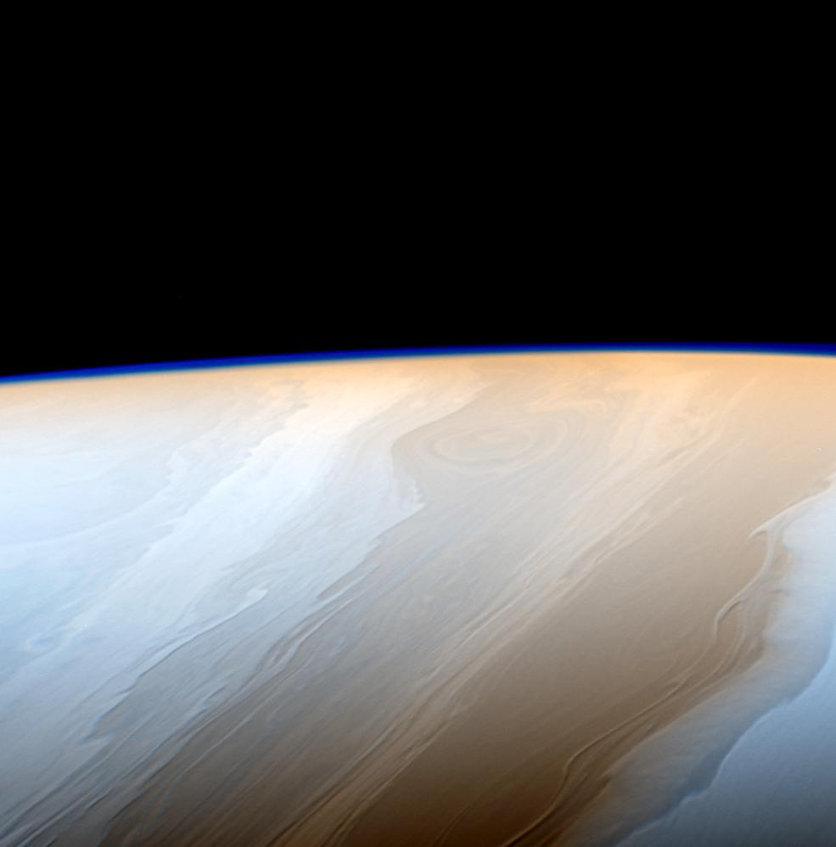
5th Planetary Data Workshop
NASA PDSIMG
Searching the Stars with Atlas IV
Kevin Grimes
Kevin.M.Grimes@jpl.nasa.gov
Co-Authors
Tariq Soliman, Anil Natha,
Rishi Verma, Michael McAuley
Thursday, July 1, 2021
©2021 California Institute of Technology. Government sponsorship acknowledged.
PIA21341

Slide 2
5th Planetary Data Workshop
Searching the Stars with Atlas IV
Overview
Introduction
What is PDS IMG
Problem Statement
Current Solutions
Atlas IV
Overview
Filtering
Map
File Explorer
Downloading
Record Views
Additional Features
Conclusion
References
July 1, 2021
©2021 California Institute of Technology. Government sponsorship acknowledged.
jpl.nasa.gov

Slide 3
5th Planetary Data Workshop
Introduction
What is PDS IMG?
Cartography and Imaging Sciences Node (IMG) of the NASA Planetary Data System (PDS)
Home to upwards of 1 PB of digital image archives
Diverse collection of images
Both orbital and landed missions
Over 20 million images taken from the surface of Mars
Nearly 5 million images taken of Mars’s surface from orbit
Images of Jupiter, Saturn, and beyond
Original, raw experiment data and derived products
Differing coordinate systems
July 1, 2021
©2021 California Institute of Technology. Government sponsorship acknowledged.
jpl.nasa.gov

Slide 4
5th Planetary Data Workshop
Introduction
Problem Statement
PDSIMG is home to well over 1000 TB of data!
How can we effectively and efficiently find the images and data we want?
July 1, 2021
©2021 California Institute of Technology. Government sponsorship acknowledged.
jpl.nasa.gov

Slide 5
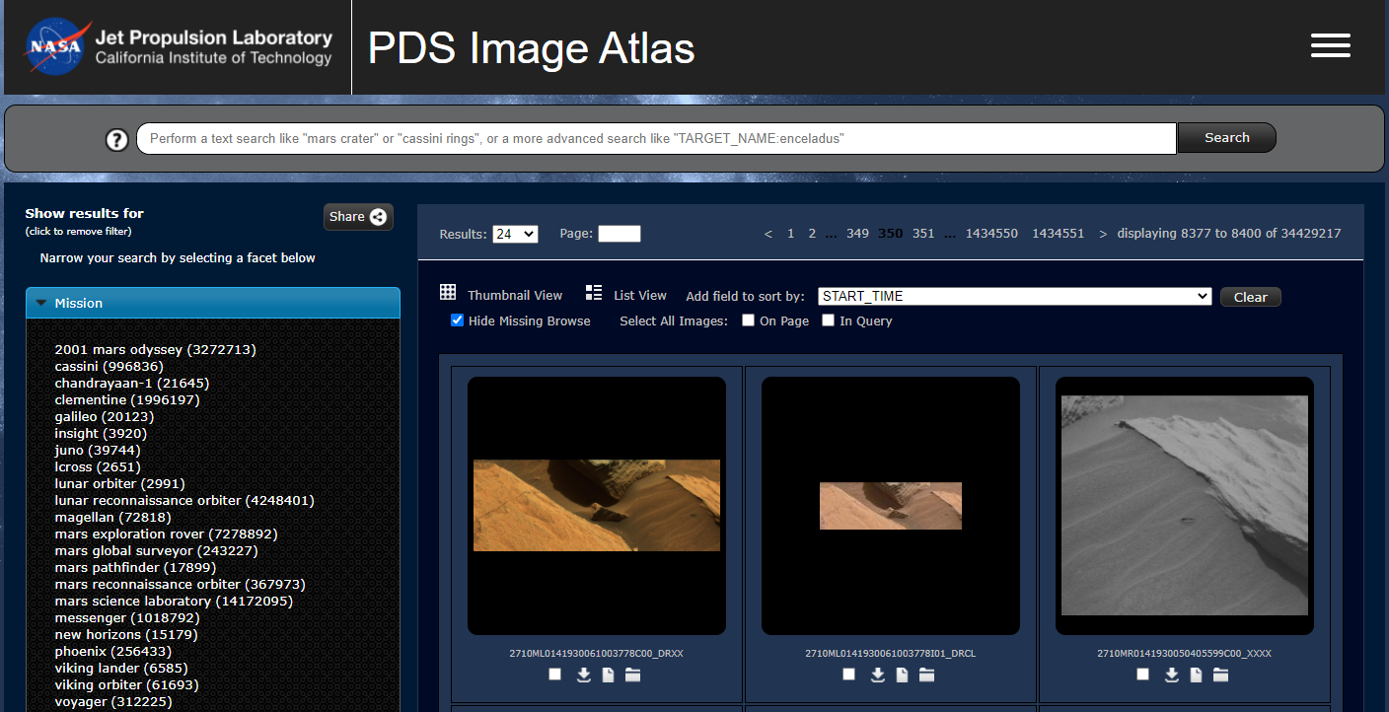
5th Planetary Data Workshop
Introduction
Current Solution
Atlas III provides effective and efficient search and access to PDS IMG’s archive.
However…
With an ever growing imagery collection and next-generation mission data, we need to ensure all our systems are highly available and scalable
Keep up with latest web technologies and design principles
Keep Atlas cohesive
Meet security and performance expectations
And Atlas III is almost a decade old now.
To meet these needs, Atlas is undergoing its fourth iteration as Atlas IV.
Atlas III
July 1, 2021
©2021 California Institute of Technology. Government sponsorship acknowledged.
jpl.nasa.gov

Slide 6
5th Planetary Data Workshop
Atlas IV
Overview
Atlas IV boasts several improvements over its predecessor and even more features
Codebase redone in favor of modern web technologies
The previous JQuery-era web application is replaced with a single-page NodeJS, React, Redux, Webpack application
Redesigned using Material UI design principles
Mobile friendly
Enhanced Filtering
Improved geospatial search support
Expanded file exploration functionalities
Streamlined the download process
Each image has its own dedicated and informational page
Tighter integration with Machine Learning classifiers
Still a work in progress.
July 1, 2021
©2021 California Institute of Technology. Government sponsorship acknowledged.
jpl.nasa.gov

Slide 7
5th Planetary Data Workshop
Atlas IV
Filtering
Filters are addable
Scales better with the 1k+ unique fields in our collection
Lower cognitive load to begin searching
Filters are now grouped categorically
Groups names include “Time”, “Spatial” and “Lighting”
Filters and fields will have supporting descriptions to help guide users to make more informed searches
Filtering is now powered by ElasticSearch instead of Solr
July 1, 2021
©2021 California Institute of Technology. Government sponsorship acknowledged.
jpl.nasa.gov

Slide 8
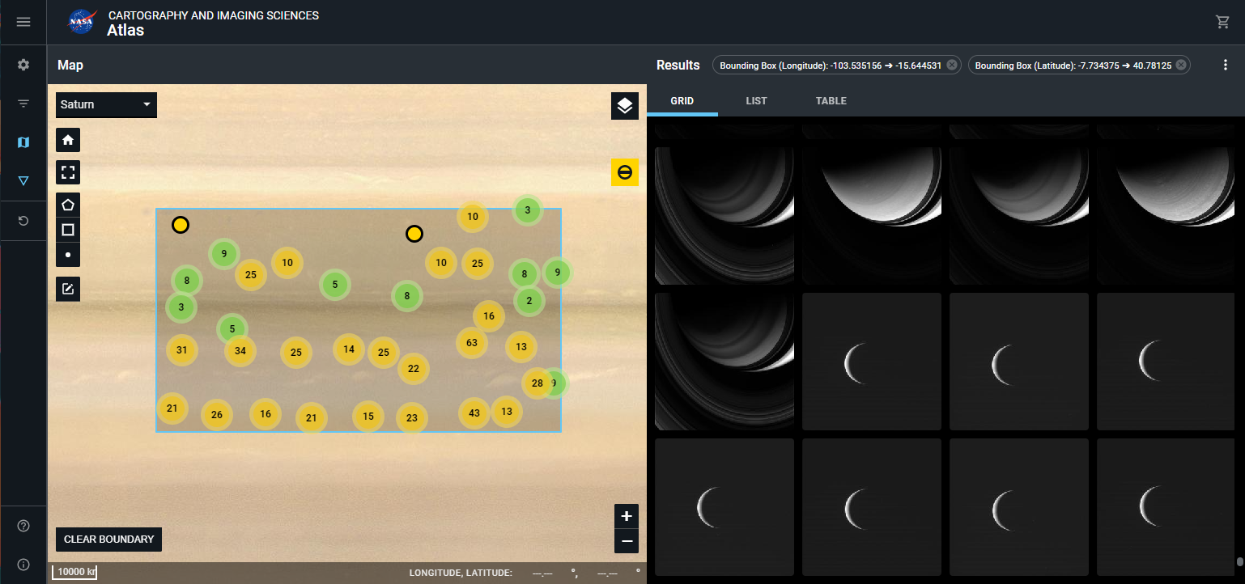
5th Planetary Data Workshop
Atlas IV
Map
User studies and interviews have shown that geospatial searching is a hotly desired feature for Atlas and one of the primary ways users want to search PDS IMG's data.
To support this, we integrated a planetary mapping library called CartoCosmos developed by our USGS partners.
It supports bounding box drawing, nearly 30 planetary bodies, polar projections and a whole suite of basemaps and layers for each.
Atlas III only provided very limited and basic geospatial support and previously only offered three planetary bodies.
July 1, 2021
©2021 California Institute of Technology. Government sponsorship acknowledged.
jpl.nasa.gov

Slide 9
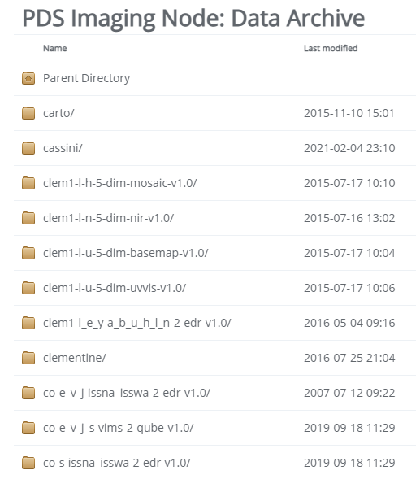
5th Planetary Data Workshop
Atlas IV
File Explorer
A file directory view to navigate our holdings that cannot adequately be searched for through facet or map-based queries.
This replaces Atlas III’s /data view which showed the file system in a raw and convoluted form.
The File Explorer utilizes ElasticSearch on the backend. This enables virtualized paths that we can use enforce clear names and conventions in the file system.
Provides a rich and reactive experience that integrates with the rest of Atlas IV.
Not only provides navigation now but also filtering, sorting and search.
July 1, 2021
©2021 California Institute of Technology. Government sponsorship acknowledged.
jpl.nasa.gov

Slide 10
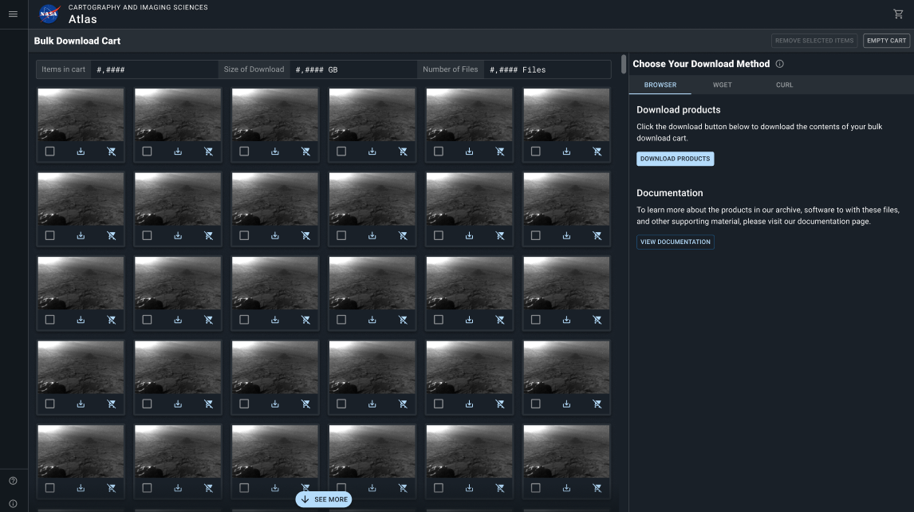
5th Planetary Data Workshop
Atlas IV
Downloading
Introducing shopping cart capability to help support mass downloads
More intuitive
Lets users browse and select items they wish to download for later
Once done, they can remove items they no longer want and perform the bulk download
Download from wget [2] and curl [3] will continued to be supported
We are still in process of exploring download methods. Some ideas are:
Asynchronous downloads that later email users a one-time zip download link
Streaming data through the browser
Special download clients that offer features like automatic retries and file prioritizations.
July 1, 2021
©2021 California Institute of Technology. Government sponsorship acknowledged.
jpl.nasa.gov

Slide 11
5th Planetary Data Workshop
Atlas IV
Record Views
Each image now has a dedicated page.
The enables sharing imagery via URL.
Imagery is interactive and can be zoomed in on and panned.
Layers, such as landmarks, can be toggled on and off.
Both image and metadata can be viewed simultaneously.
The label is interactive and can be search and filtering upon.
The record view is incredibly extensible with its tabbed view — supporting the future creation of refined and analytic views such as 3D context and orientation.
July 1, 2021
©2021 California Institute of Technology. Government sponsorship acknowledged.
jpl.nasa.gov

Slide 12
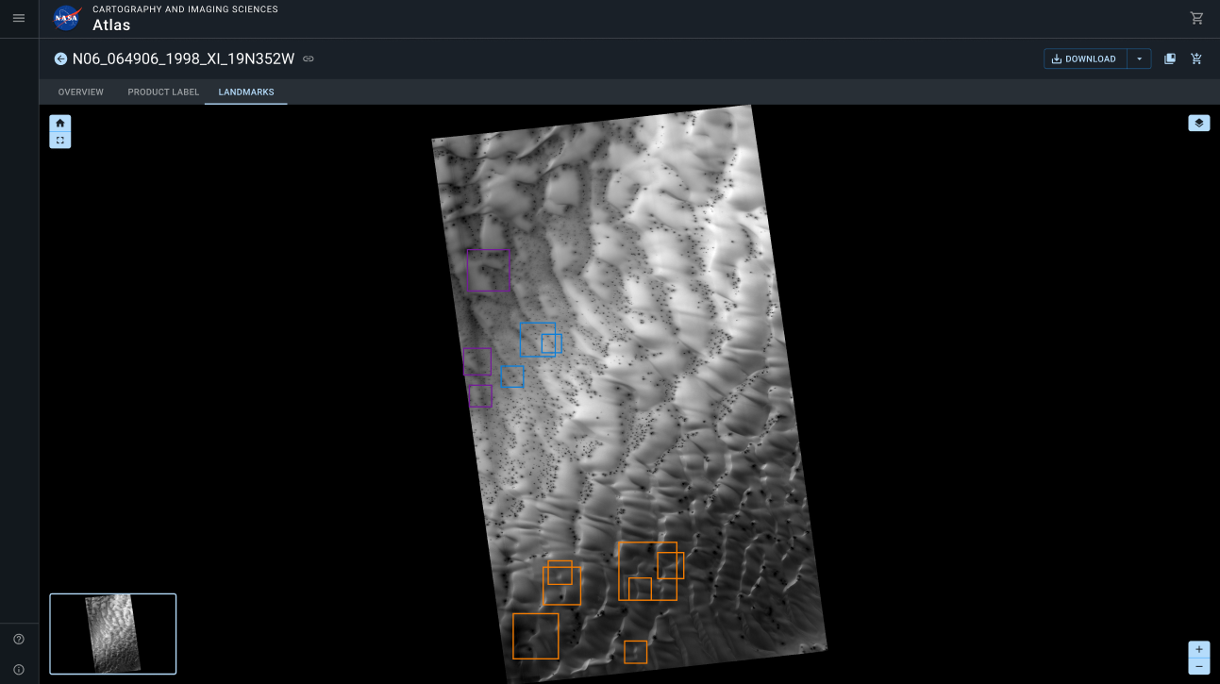
5th Planetary Data Workshop
Atlas IV
Additional Features
Mobile friendly
Closer Integration with machine learning capabilities
Extensive help to aid new users
Highly Extensible codebase for future improvement
Virtualized, lazy-loaded and infinite scrolling results
A shared design system and tighter relationship with the main PDS Imaging site
July 1, 2021
©2021 California Institute of Technology. Government sponsorship acknowledged.
jpl.nasa.gov

Slide 13
5th Planetary Data Workshop
Conclusion
+ Work to Go
Atlas IV, while still in the works, is an evolutionary and revolutionary reimaging of its predecessor Atlas III.
Atlas IV will:
Be compliant with modern web standards.
Rework filtering to be intuitive and scalable.
Feature geospatial capabilities at its core.
Revamp file exploration with new searching options, orderly hierarchies, and standardized naming conventions.
Download functionality will be robust and highly integrated.
Product images will be presented through dedicated pages and will enable tailored insights into the data.
July 1, 2021
©2021 California Institute of Technology. Government sponsorship acknowledged.
jpl.nasa.gov

Slide 14
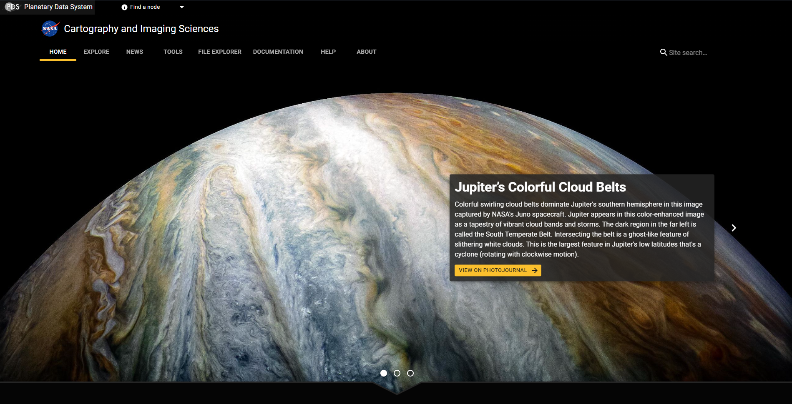
5th Planetary Data Workshop
Conclusion
PDSIMG Website Preview
Atlas IV is part of a larger rework of PDS IMG for integration with ongoing web unification efforts.
1) Main site (pds-imaging.jpl.nasa.gov) 2) Backend API 3) ML Classification
July 1, 2021
©2021 California Institute of Technology. Government sponsorship acknowledged.
jpl.nasa.gov

Slide 15
5th Planetary Data Workshop
References
[1] CartoCosmos https://ceias.nau.edu/capstone/projects/CS/2020/Carto Cosmos-S20/
[2] wget https://www.gnu.org/software/wget/
[3] curl https://curl.se/
July 1, 2021
©2021 California Institute of Technology. Government sponsorship acknowledged.
jpl.nasa.gov

Slide 16
5th Planetary Data Workshop
jpl.nasa.gov
July 1, 2021
©2021 California Institute of Technology. Government sponsorship acknowledged.
jpl.nasa.gov

Slide 17
5th Planetary Data Workshop
Backups
July 1, 2021
©2021 California Institute of Technology. Government sponsorship acknowledged.
jpl.nasa.gov

Slide 18
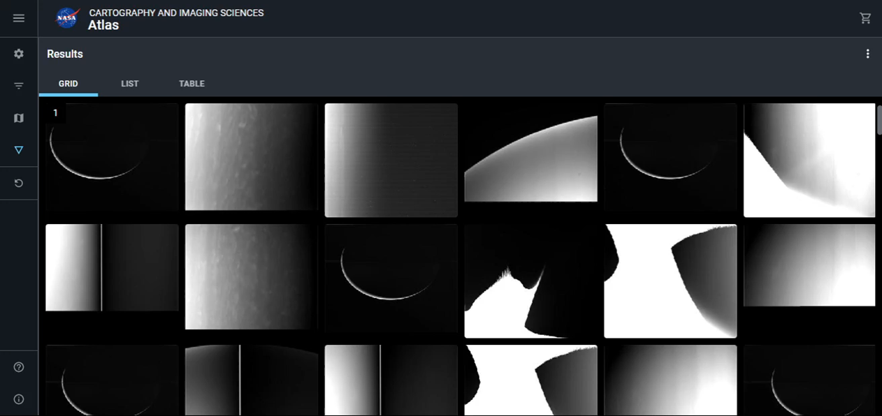
5th Planetary Data Workshop
Map Animation
July 1, 2021
©2021 California Institute of Technology. Government sponsorship acknowledged.
jpl.nasa.gov

