Slide 1
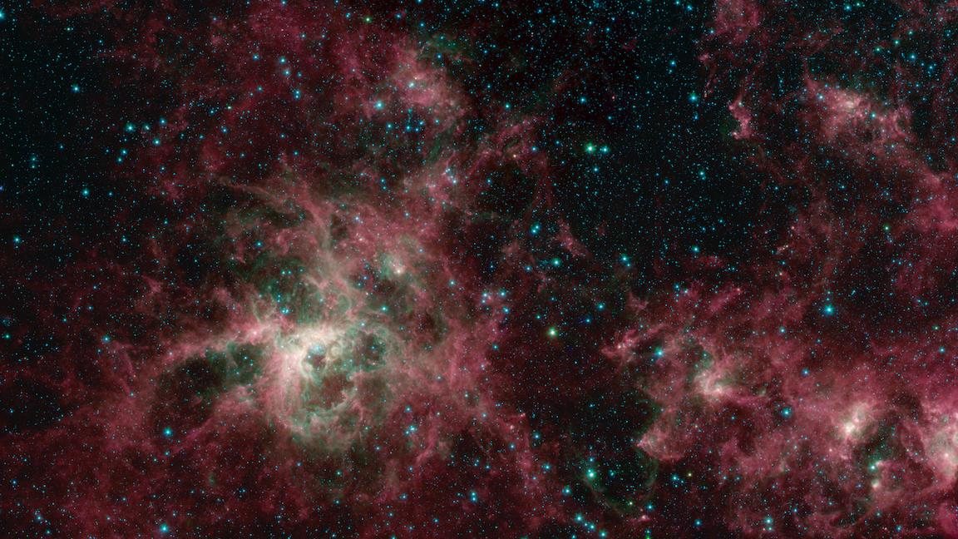
Searching the Stars with Atlas IV
Kevin Grimes
kevin.m.grimes@jpl.caltech.edu
23 June 2022
3rd Planetary Science Informatics and Data Analytics Conference

Slide 2
Searching the Stars with Atlas IV
3rd Planetary Science Informatics and Data Analytics Conference
Overview
Background | Motivation | Atlas IV | Next steps | References
https://bit.ly/39DJfZy

Slide 3
Searching the Stars with Atlas IV
3rd Planetary Science Informatics and Data Analytics Conference
Overview
Background | Motivation | Atlas IV | Next steps | References

Slide 4
Searching the Stars with Atlas IV
3rd Planetary Science Informatics and Data Analytics Conference
Background
“PDS Imaging Node” = Cartography and Imaging Sciences Node of the Planetary Data System
One node, two facilities – USGS & JPL
Home to upwards of 1PB of planetary digital archives

Slide 5
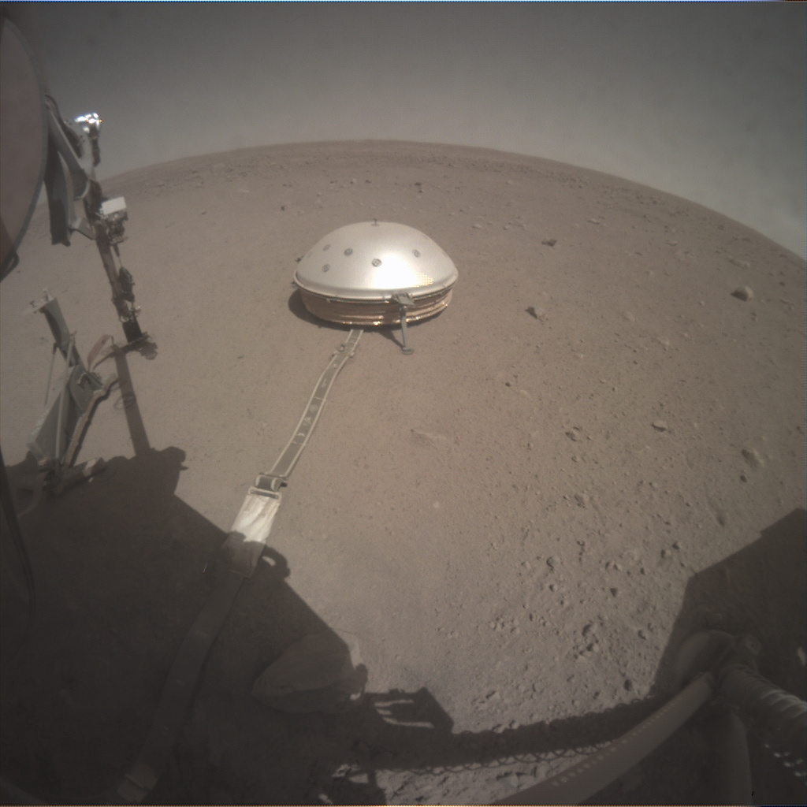
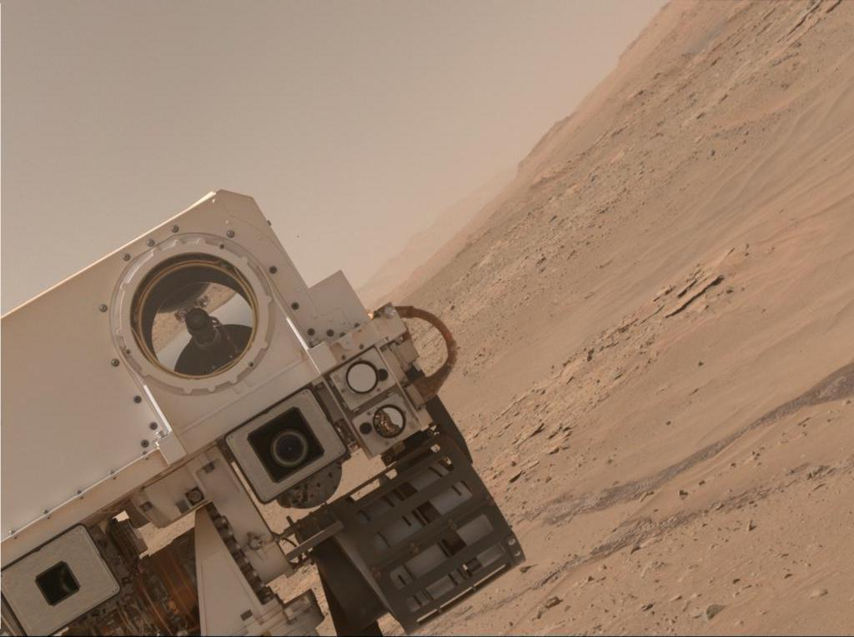
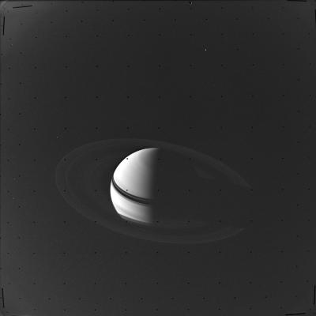
Searching the Stars with Atlas IV
3rd Planetary Science Informatics and Data Analytics Conference
Background
“PDS Imaging Node” = Cartography and Imaging Sciences Node of the Planetary Data System
One node, two facilities – USGS & JPL
Home to upwards of 1PB of planetary digital archives
Diverse collection of products
Landers, rovers, orbiters, and probes
PDS3 and PDS4
Imagery, maps, and other products

Slide 6
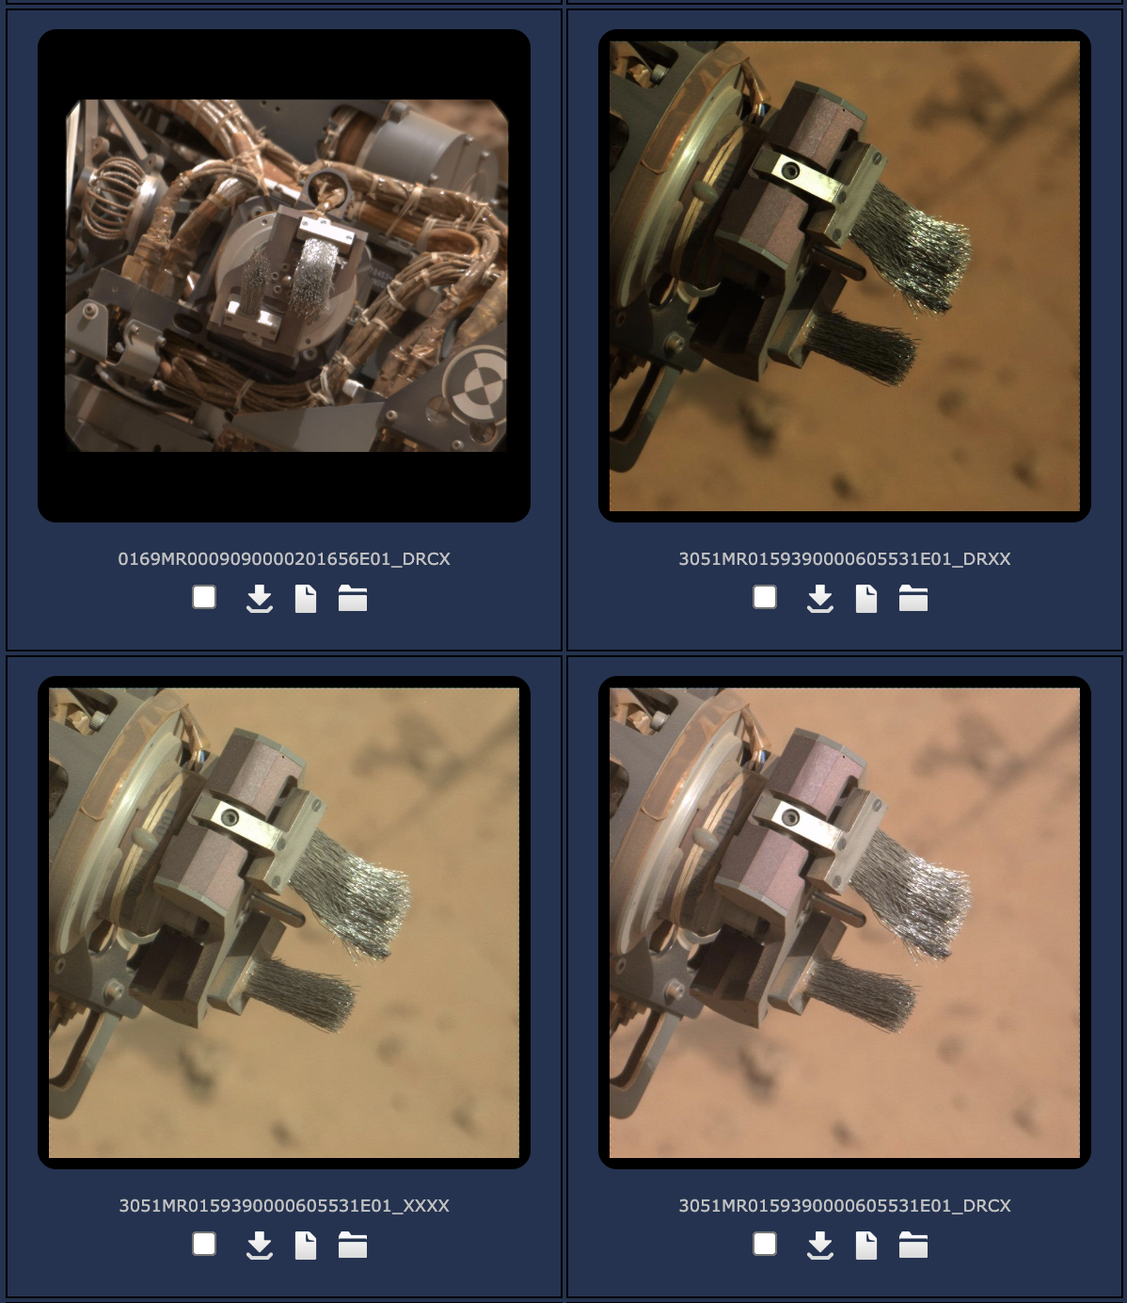
Searching the Stars with Atlas IV
3rd Planetary Science Informatics and Data Analytics Conference
Background
“PDS Imaging Node” = Cartography and Imaging Sciences Node of the Planetary Data System
One node, two facilities – USGS & JPL
Home to upwards of 1PB of planetary digital archives
Diverse collection of products
Landers, rovers, orbiters, and probes
PDS3 and PDS4
Imagery, maps, and other products
Over 1.2M images across 5 missions enhanced by ML processes

Slide 7
Searching the Stars with Atlas IV
3rd Planetary Science Informatics and Data Analytics Conference
Overview
Background | Motivation | Atlas IV | Next steps | References

Slide 8
Searching the Stars with Atlas IV
3rd Planetary Science Informatics and Data Analytics Conference
Motivation
Challenge: Enable users to effectively locate data they need to do their research
Partially solved with Atlas III

Slide 9
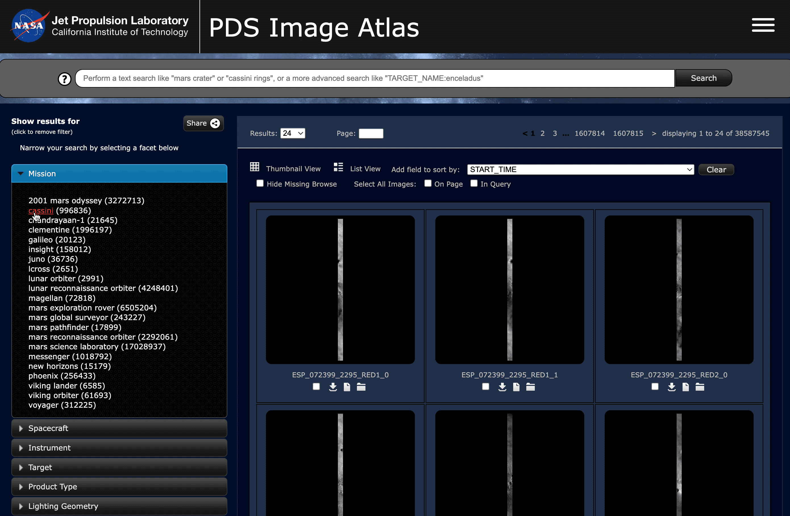
Searching the Stars with Atlas IV
3rd Planetary Science Informatics and Data Analytics Conference
Motivation
Atlas III
Faceted search on hundreds of PDS3 keywords from multiple missions

Slide 10
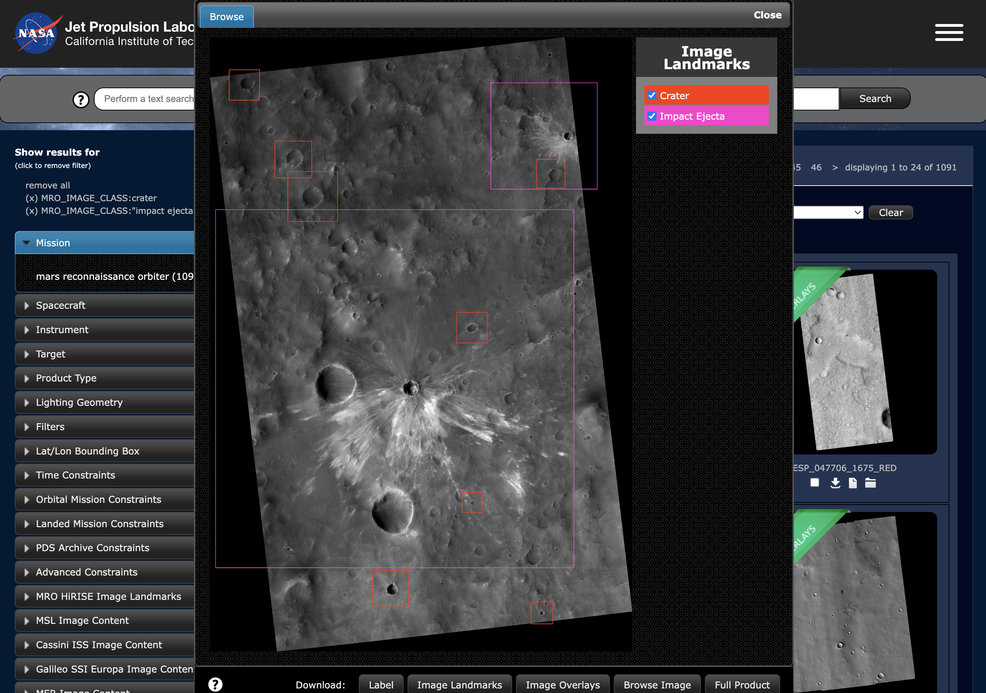
Searching the Stars with Atlas IV
3rd Planetary Science Informatics and Data Analytics Conference
Motivation
Atlas III
Faceted search on hundreds of PDS3 keywords from multiple missions
Download original products, as well as their browse imagery and label
Report generator
Powered by ML (feature bounding boxes, class faceting)

Slide 11
Searching the Stars with Atlas IV
3rd Planetary Science Informatics and Data Analytics Conference
Motivation
It’s great, but…
Availability and scalability concerns
Security and performance expectations
Downloading lots of data at once is a hassle
Doesn’t work on a phone
Built nearly a decade ago using technologies that have since become outdated

Slide 12
Searching the Stars with Atlas IV
3rd Planetary Science Informatics and Data Analytics Conference
Overview
Background | Motivation | Atlas IV | Next steps | References

Slide 13
Searching the Stars with Atlas IV
3rd Planetary Science Informatics and Data Analytics Conference
Atlas IV
Single-page NodeJS, React, Redux, Webpack application
Material UI
Mobile friendly
Enhanced filtering
Improved geospatial search support
Expanded file exploration functionalities
Streamlined download process
Tighter integration with machine learning classifiers

Slide 14
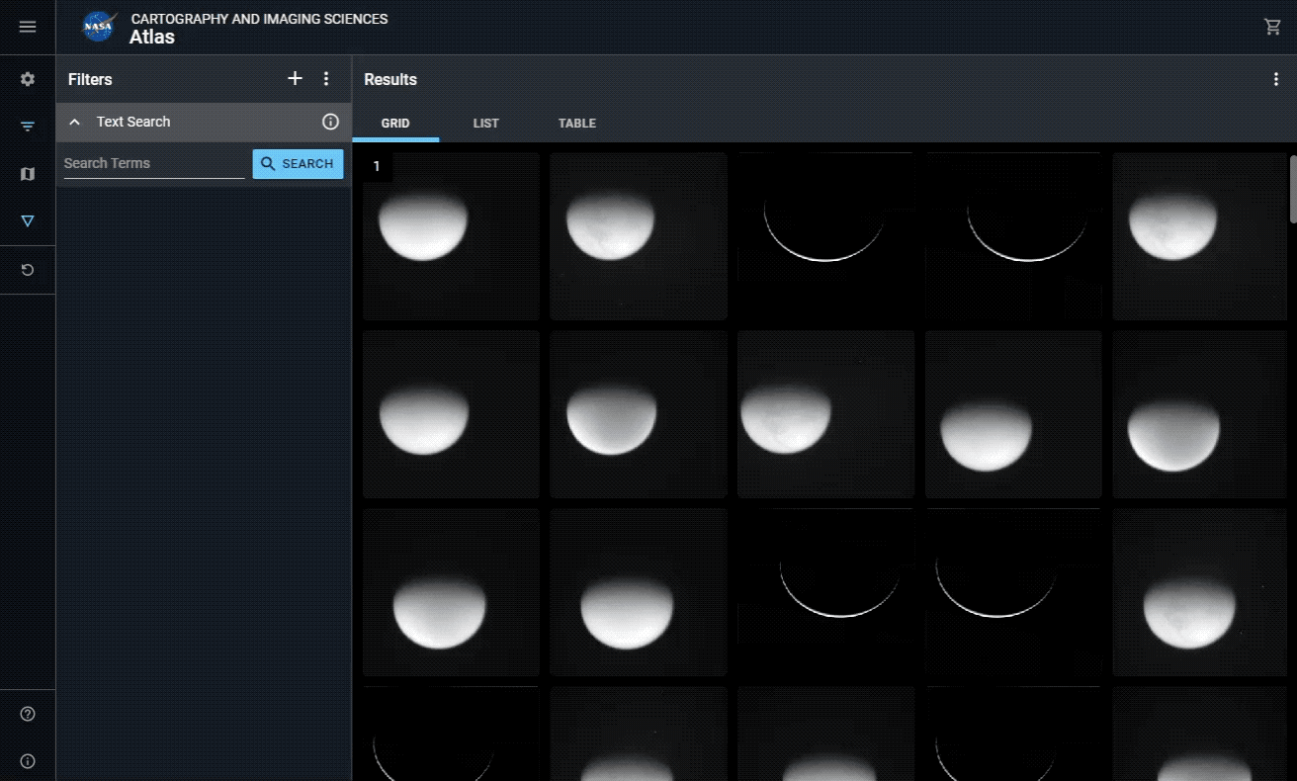
Searching the Stars with Atlas IV
3rd Planetary Science Informatics and Data Analytics Conference
Atlas IV
Facets are addable
Scales better with the the 1k+ unique fields in our collection
Lowers cognitive load
Facets are now categorized
Time
Spatial
Lighting
Supporting documentation for fields parsed from PDS archival documentation
Faceting is now powered by IMG’s Search API

Slide 15
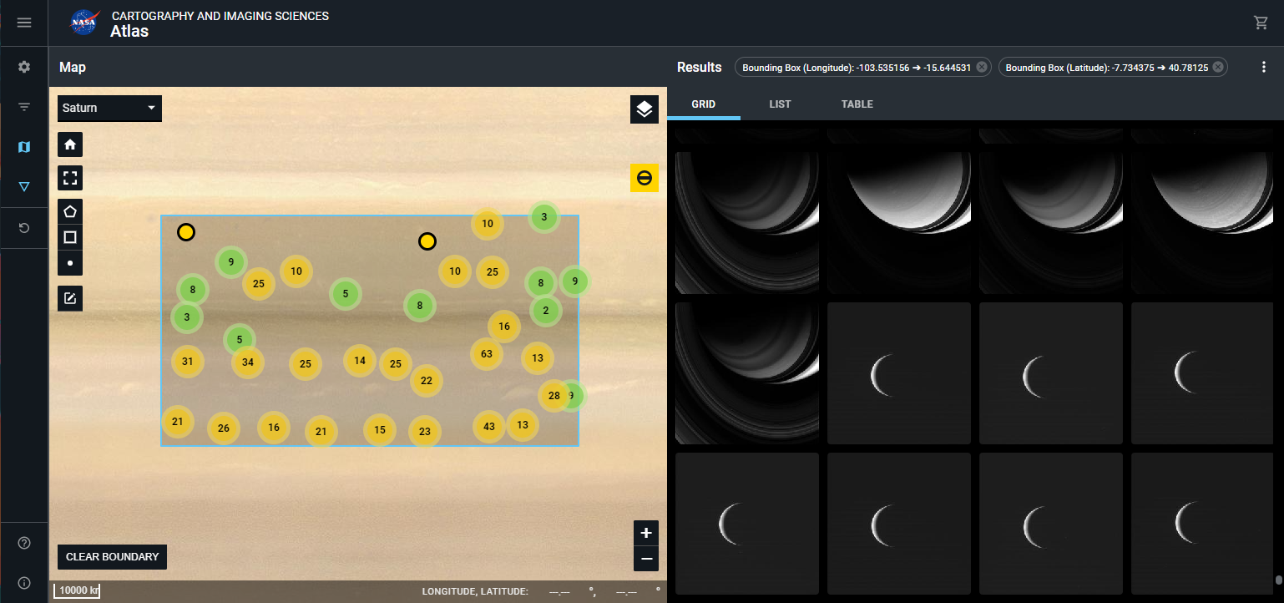
Searching the Stars with Atlas IV
3rd Planetary Science Informatics and Data Analytics Conference
Atlas IV
Geospatial search enabled via integration with CartoCosmos¹
Supports
Bounding box drawing,
Nearly 30 planetary bodies,
Polar projections, and
A whole suite of basemaps and layers for each

Slide 16
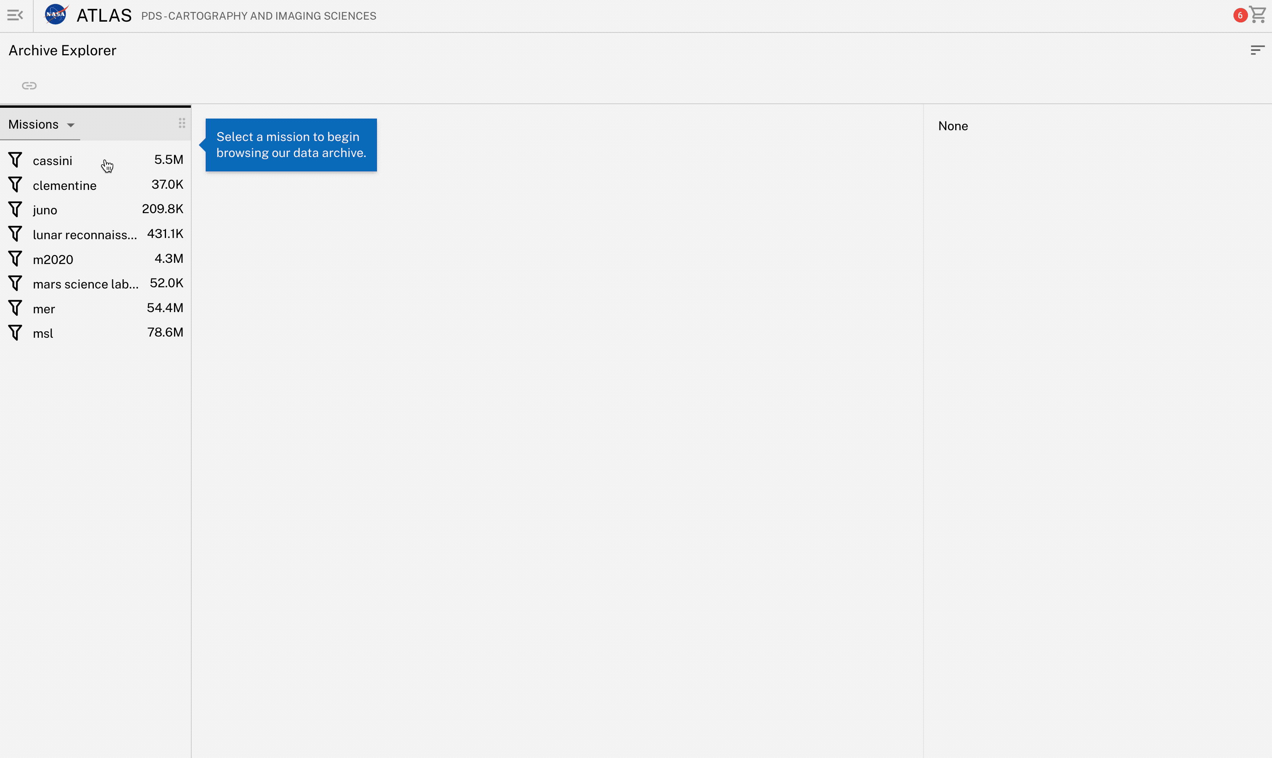
Searching the Stars with Atlas IV
3rd Planetary Science Informatics and Data Analytics Conference
Atlas IV
File directory view
Utilized IMG’s Data Access API (virtualized paths)
Provides a rich and reactive experience that integrates with the rest of Atlas IV
Provides navigation, filtering, sorting, and basic search

Slide 17
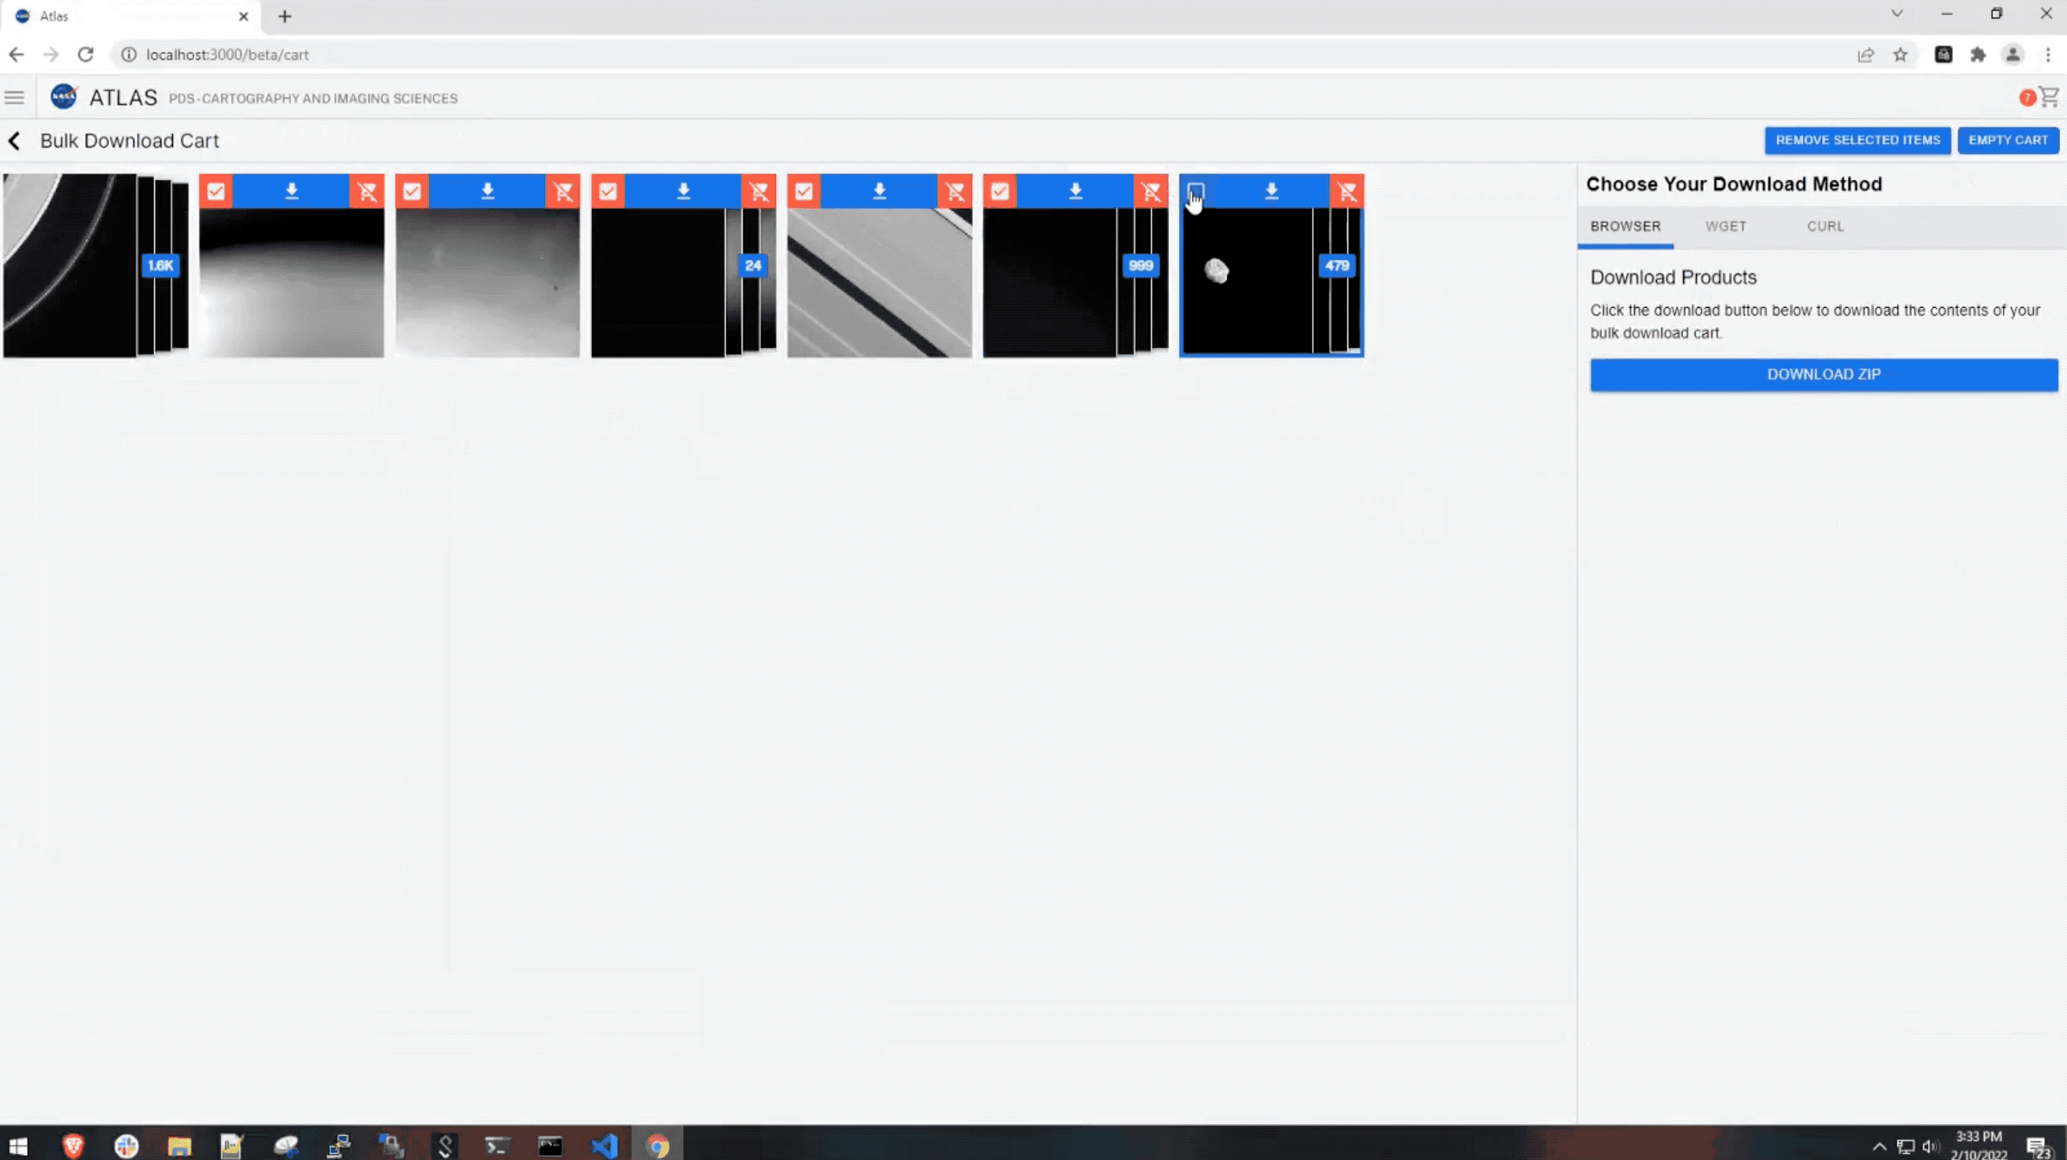
Searching the Stars with Atlas IV
3rd Planetary Science Informatics and Data Analytics Conference
Atlas IV
Shopping cart
Streamlines download of large counts of files
Mark items as you’re browsing, download later
Remove items no longer wanted
Streams to ZIP file (also curl and wget)
Pause and resume transfer
Status reporting
JSON manifest

Slide 18
Searching the Stars with Atlas IV
3rd Planetary Science Informatics and Data Analytics Conference
Atlas IV
Dedicated image pages
Interactive zooming and panning
Toggleable layers, including landmarks
Simultaneous viewing of both image and label
Interactive label with feedback loop

Slide 19
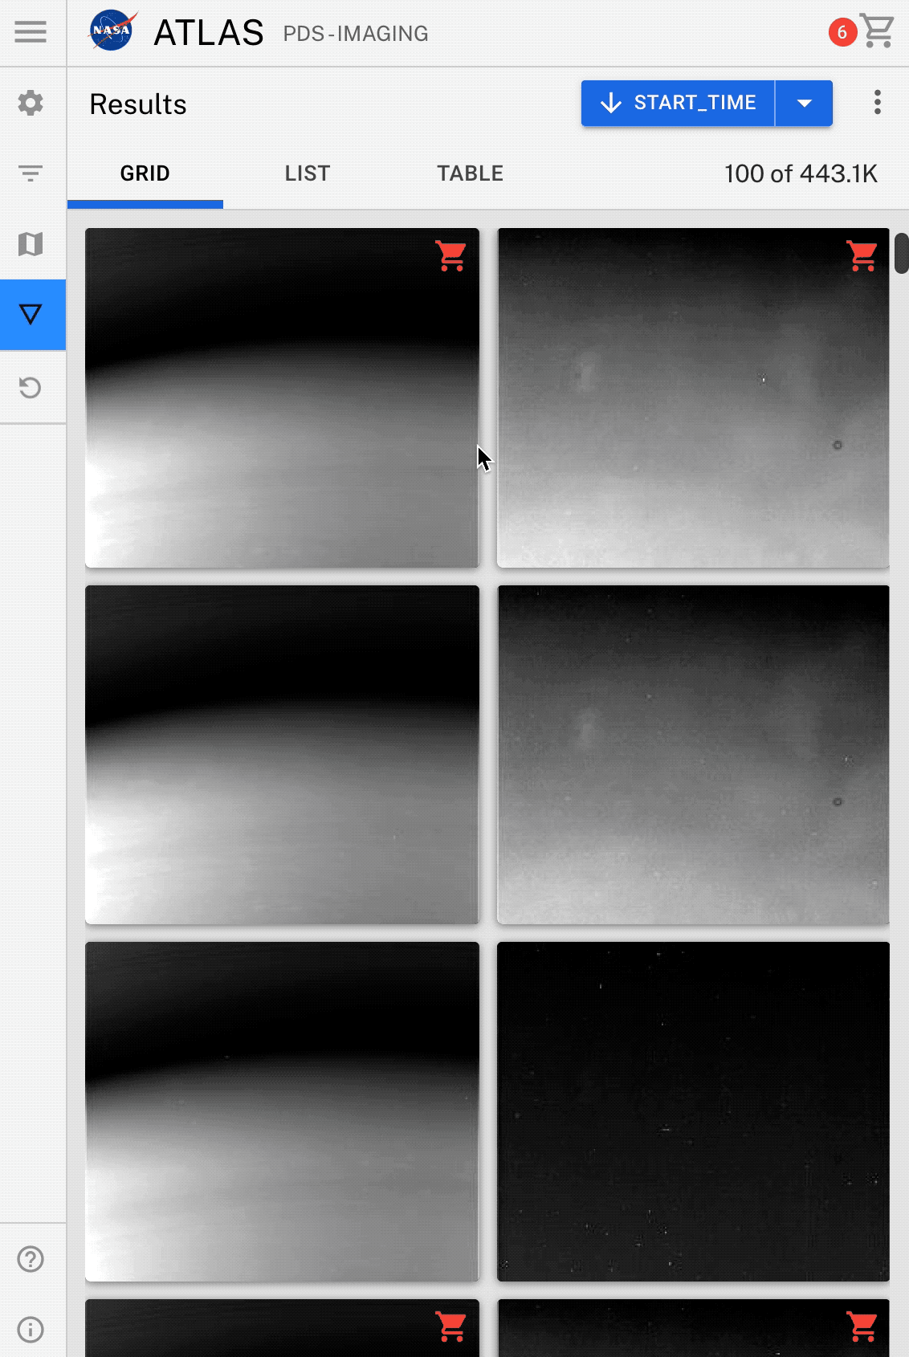
Searching the Stars with Atlas IV
3rd Planetary Science Informatics and Data Analytics Conference
Atlas IV
Mobile friendly
Extensive help for new users
Closer integration with machine learning capabilities
Highly extensible codebase for future improvement
Virtualized, lazy-loaded, and infinite scrolling results
Shared design system and tighter relationship with the main PDS Imaging site
Light and dark mode

Slide 20
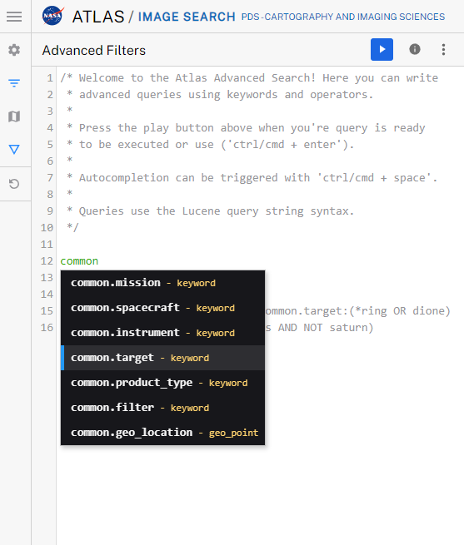
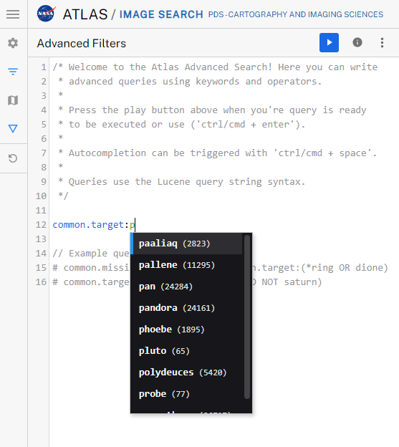
Searching the Stars with Atlas IV
3rd Planetary Science Informatics and Data Analytics Conference
Atlas IV
Mobile friendly
Extensive help for new users
Closer integration with machine learning capabilities
Highly extensible codebase for future improvement
Virtualized, lazy-loaded, and infinite scrolling results
Shared design system and tighter relationship with the main PDS Imaging site
Light and dark mode
Advanced search with syntax highlighting and autocomplete

Slide 21
Searching the Stars with Atlas IV
3rd Planetary Science Informatics and Data Analytics Conference
Overview
Background | Motivation | Atlas IV | Next steps | References

Slide 22
Searching the Stars with Atlas IV
3rd Planetary Science Informatics and Data Analytics Conference
Next steps
Support all data from Atlas III
Full integration with PDS API
DEMUD² classifier integration (novelty)
Generate tiled versions of our browse imagery
😱 Public beta early FY23 😎

Slide 23
Searching the Stars with Atlas IV
3rd Planetary Science Informatics and Data Analytics Conference
Next steps
Support all data from Atlas III
Full integration with PDS API
DEMUD² classifier integration (novelty)
Generate tiled versions of our browse imagery
😱 Public beta early FY23 😎

Slide 24
Searching the Stars with Atlas IV
3rd Planetary Science Informatics and Data Analytics Conference
Overview
Background | Motivation | Atlas IV | Next steps | References

Slide 25
Searching the Stars with Atlas IV
3rd Planetary Science Informatics and Data Analytics Conference
References
Cover slide graphic: “PIA23647: Tarantula Nebula Spitzer 3-Color Image”, retrieved from https://photojournal.jpl.nasa.gov/catalog/PIA23647
Background graphic of all other slides: “PIA23647: Tarantula Nebula Spitzer 3-Color Image”, retrieved from https://photojournal.jpl.nasa.gov/catalog/PIA25161
[1] https://github.com/PlanetMap/CartoCosmos
[2] https://github.com/wkiri/DEMUD
More information on the IMG API and the cloud-first architecture it implements may be found here: https://bit.ly/3QDPxc1
Slides for this presentation: https://bit.ly/39DJfZy
Contact me: kevin.m.grimes@jpl.caltech.edu

