Slide 1
5th Planetary Data Workshop & 2nd Planetary Science Informatics and Data Analytics Meeting
Cloud Processing of PDS Archival Products with Amazon Web Services, Kubernetes, and Elasticsearch
Kevin Grimes – kevin.m.grimes@jpl.nasa.gov
Co-Authors: Rishi Verma, James Michael McAuley, Tariq Soliman, Anil Natha, Zachary M. Taylor
Wednesday, June 30, 2021

Slide 2
Cloud Processing of PDS Archival Products
5th Planetary Data Workshop & 2nd Planetary Science Informatics and Data Analytics Meeting
Overview
Introduction
Architecture
Deployment
Conclusions
Future Work
References

Slide 3
Introduction
5th Planetary Data Workshop & 2nd Planetary Science Informatics and Data Analytics Meeting
Overview
PDS Imaging Node
Existing backend architecture
Motivation to evolve

Slide 4
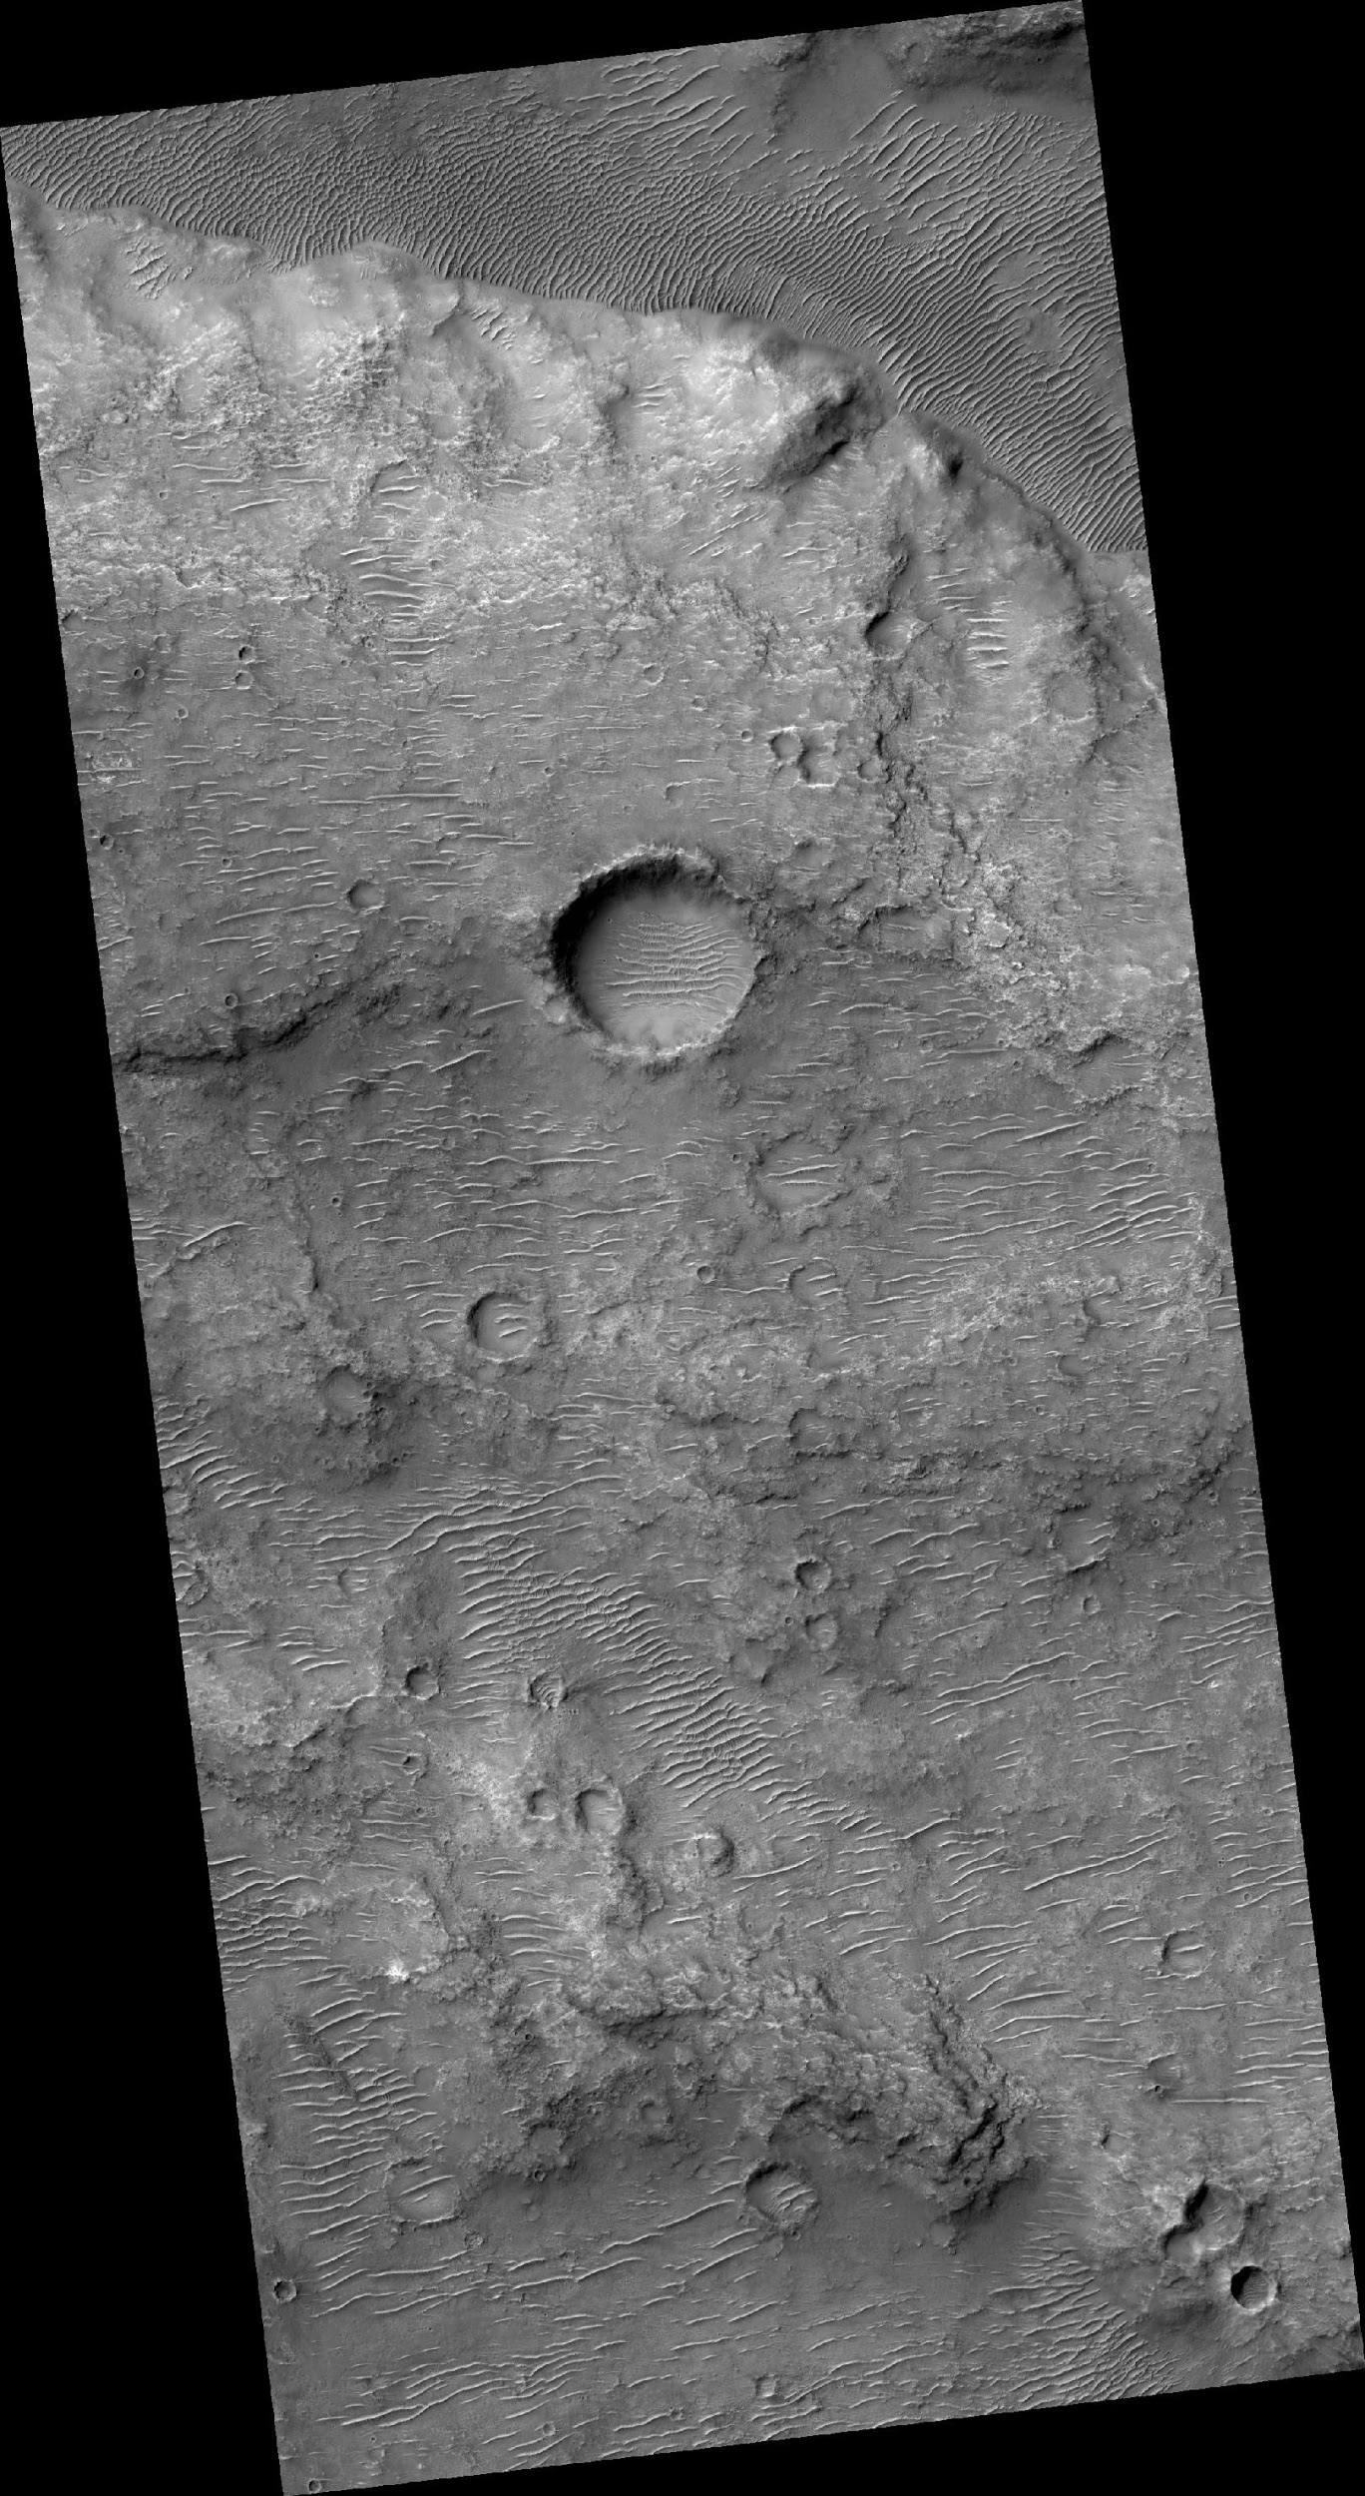
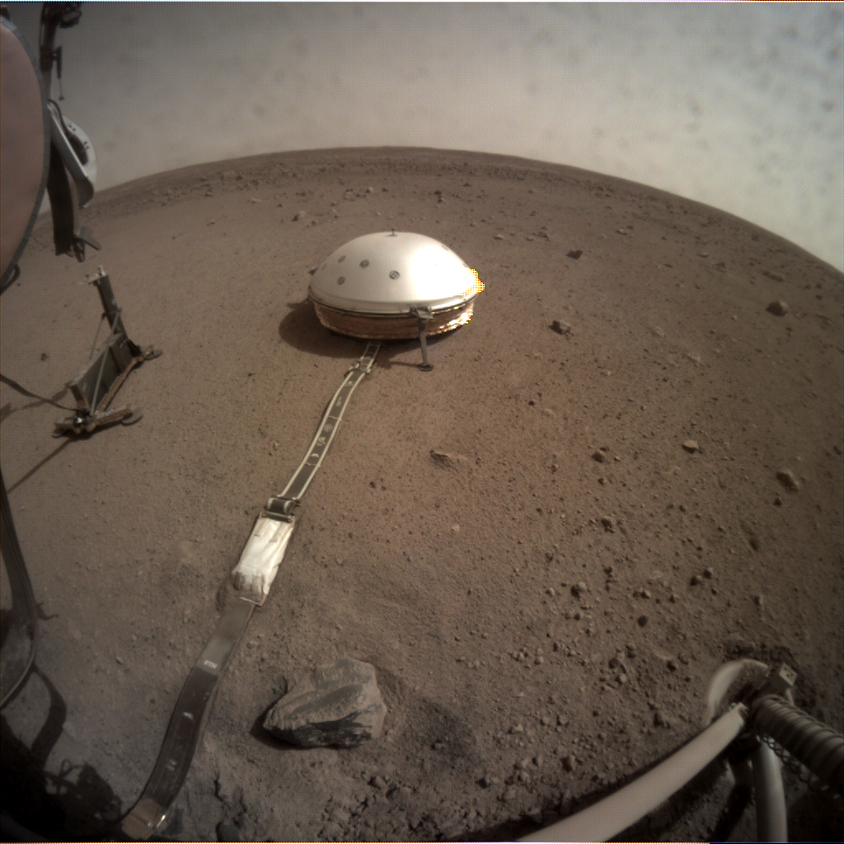
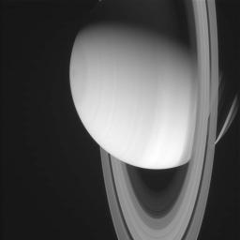
Introduction
5th Planetary Data Workshop & 2nd Planetary Science Informatics and Data Analytics Meeting
PDS Imaging Node
Cartography and Imaging Sciences Node (IMG) of the NASA Planetary Data System (PDS)
Home to nearly 2 PB of digital image archives
Diverse collection of images
Both orbital and landed missions
Over 20 million images takes from the surface of Mars
Nearly 5 million images taken of Mars’s surface from orbit
Images of Saturn, Jupiter, and Beyond
Original, raw experiment data and derived products
Differing coordinate systems

Slide 5
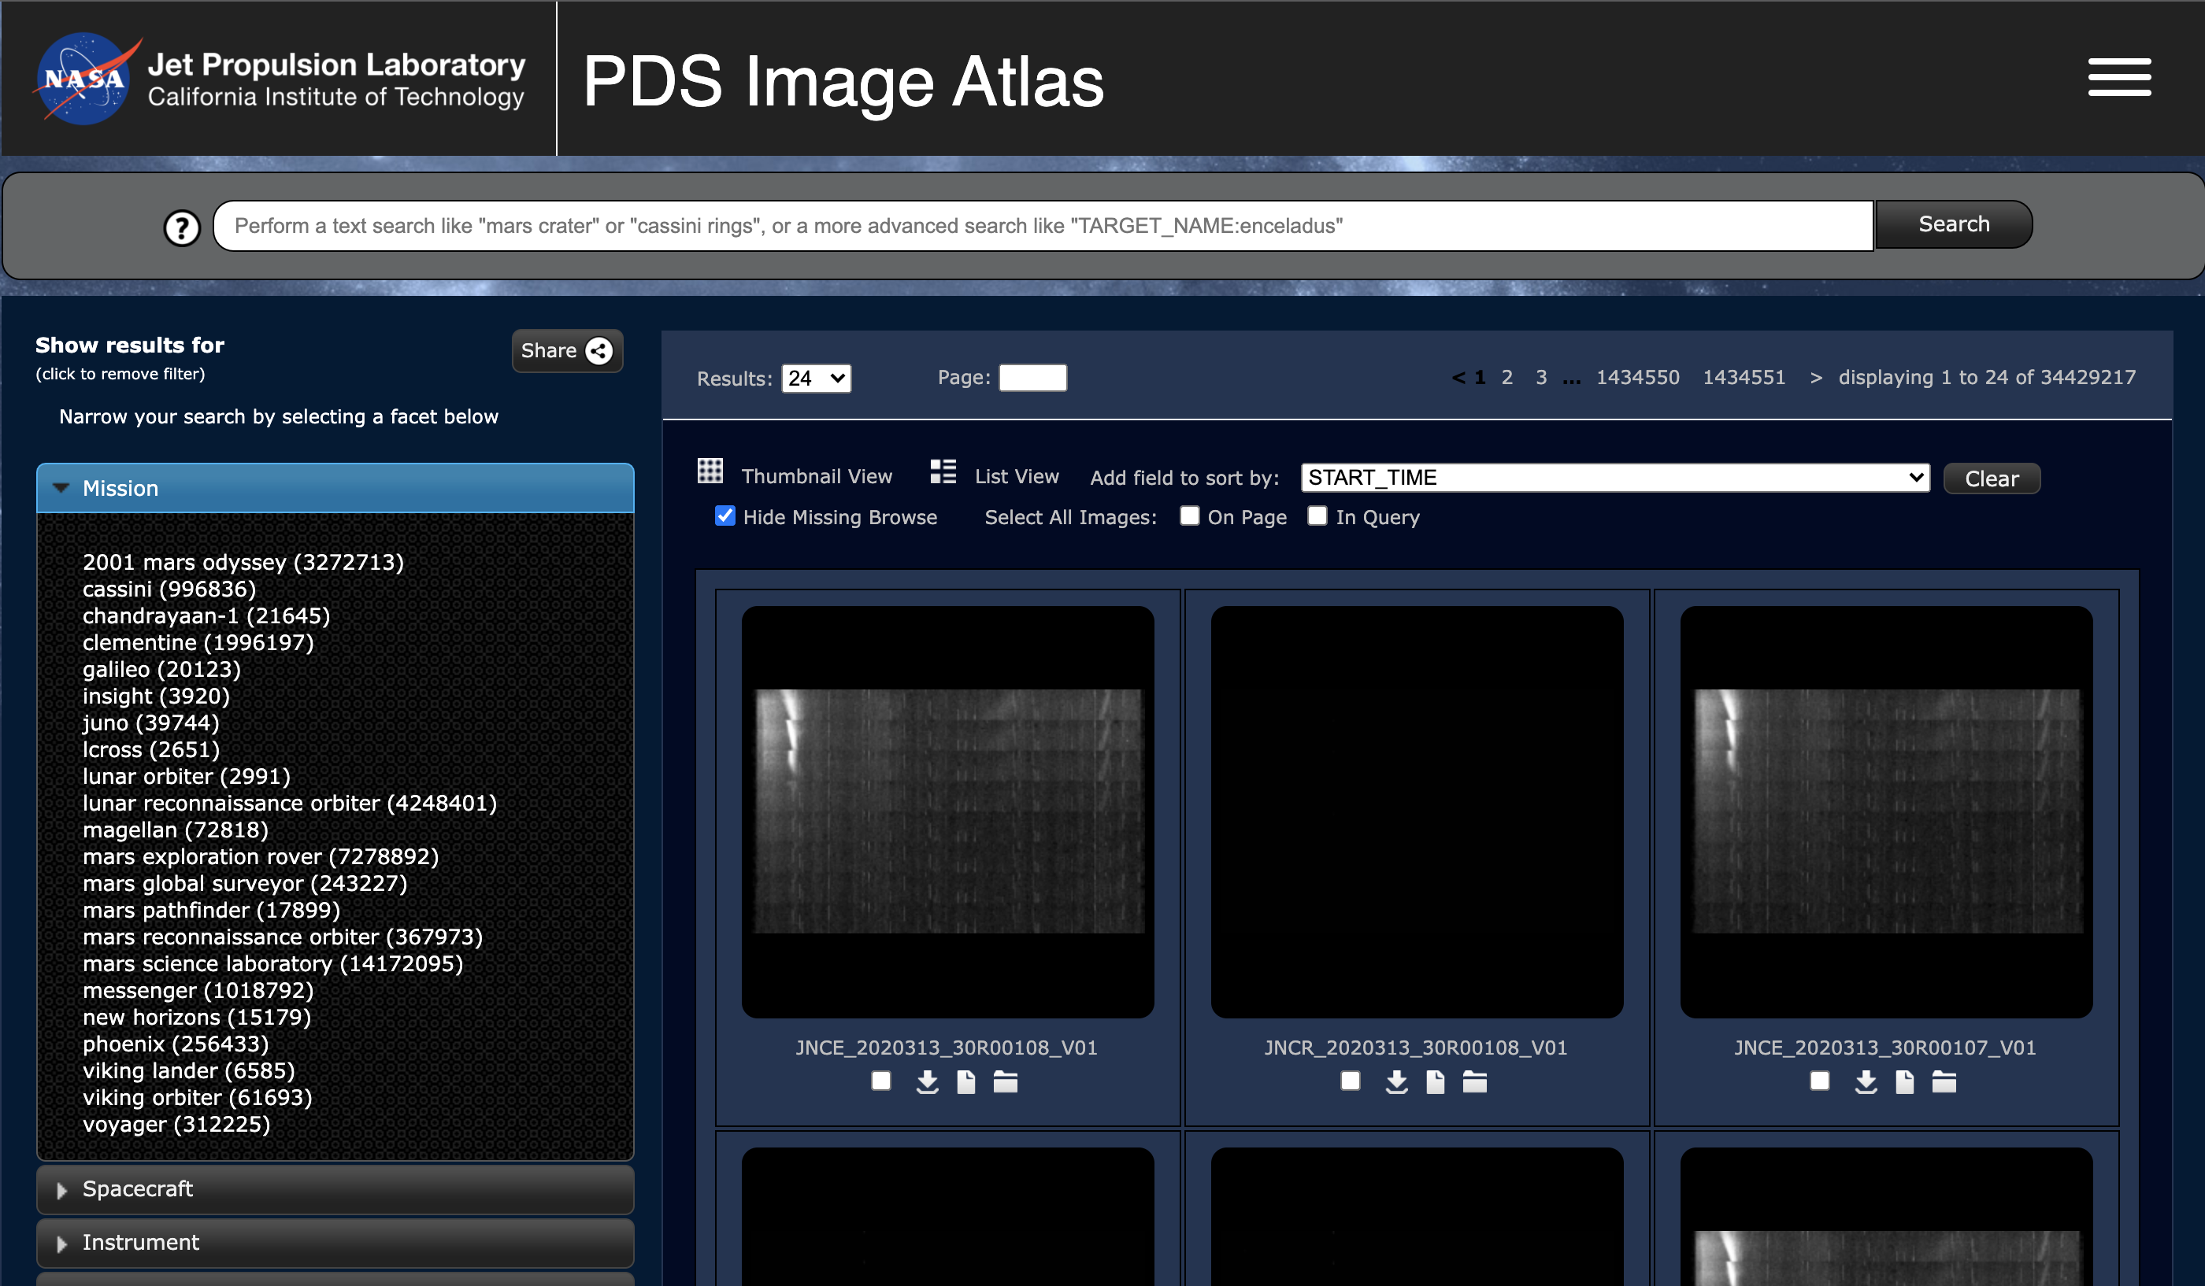
Introduction
5th Planetary Data Workshop & 2nd Planetary Science Informatics and Data Analytics Meeting
Existing backend architecture
Image Atlas
Primary tool for discovering data in IMG’s archives
JavaScript webapp running on-premises
Interacts directly with Apache Solr backend
Data access
Search
https://pds-imaging.jpl.nasa.gov/search

Slide 6
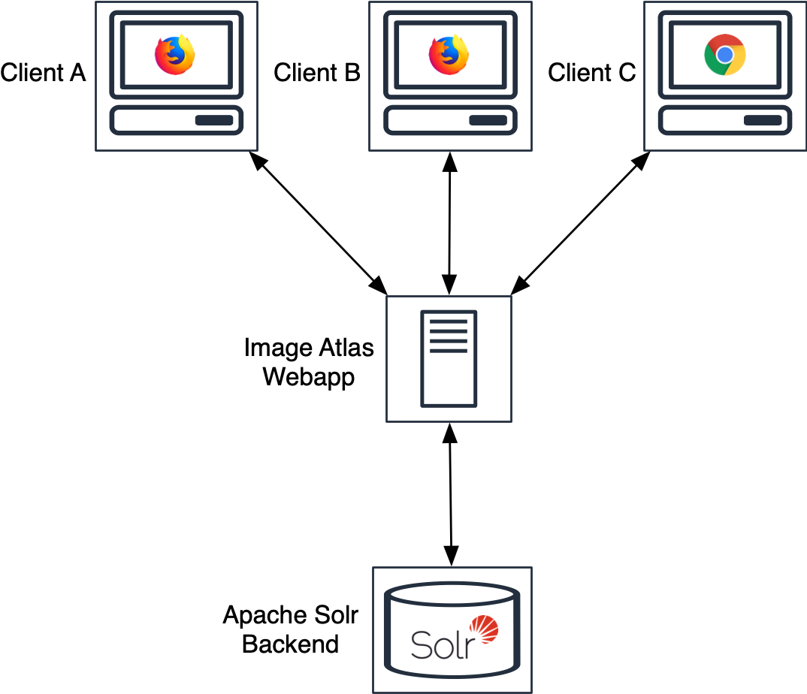
Introduction
5th Planetary Data Workshop & 2nd Planetary Science Informatics and Data Analytics Meeting
Existing backend architecture
Image Atlas
Primary tool for discovering data in IMG’s archives
JavaScript webapp running on-premises
Interacts directly with Apache Solr backend
Data access
Search
https://pds-imaging.jpl.nasa.gov/search

Slide 7
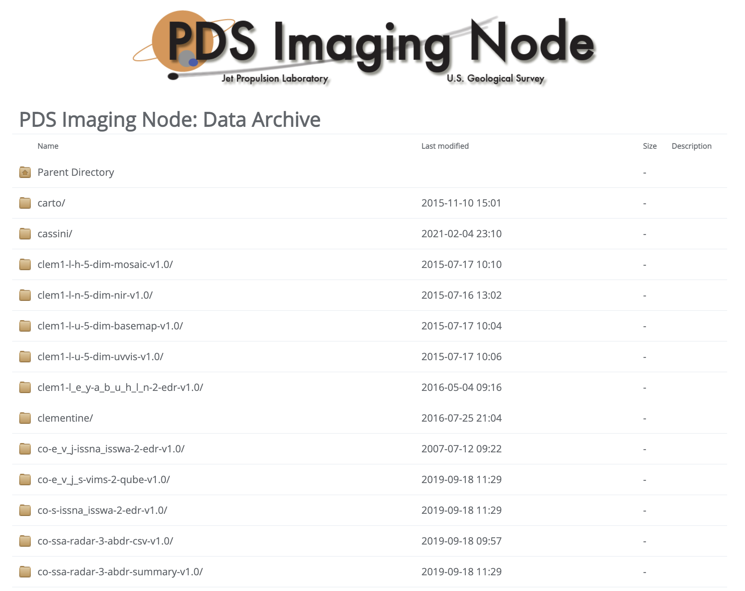
Introduction
5th Planetary Data Workshop & 2nd Planetary Science Informatics and Data Analytics Meeting
Existing backend architecture
Image Atlas
Data access
Data products served over HTTPS
Simple HTML frontend rendering archives as they exist on disk
Search
https://pds-imaging.jpl.nasa.gov/data

Slide 8
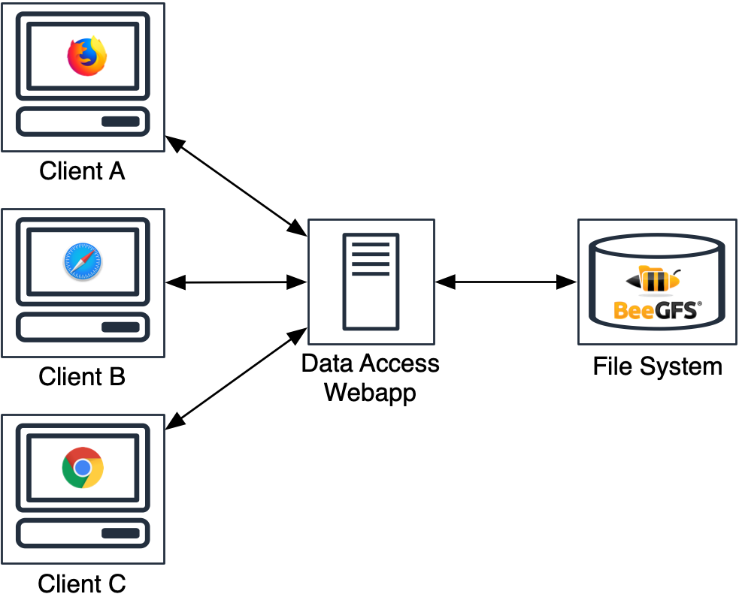
Introduction
5th Planetary Data Workshop & 2nd Planetary Science Informatics and Data Analytics Meeting
Existing backend architecture
Image Atlas
Data access
Data products served over HTTPS
Simple HTML frontend rendering archives as they exist on disk
Search
https://pds-imaging.jpl.nasa.gov/data

Slide 9
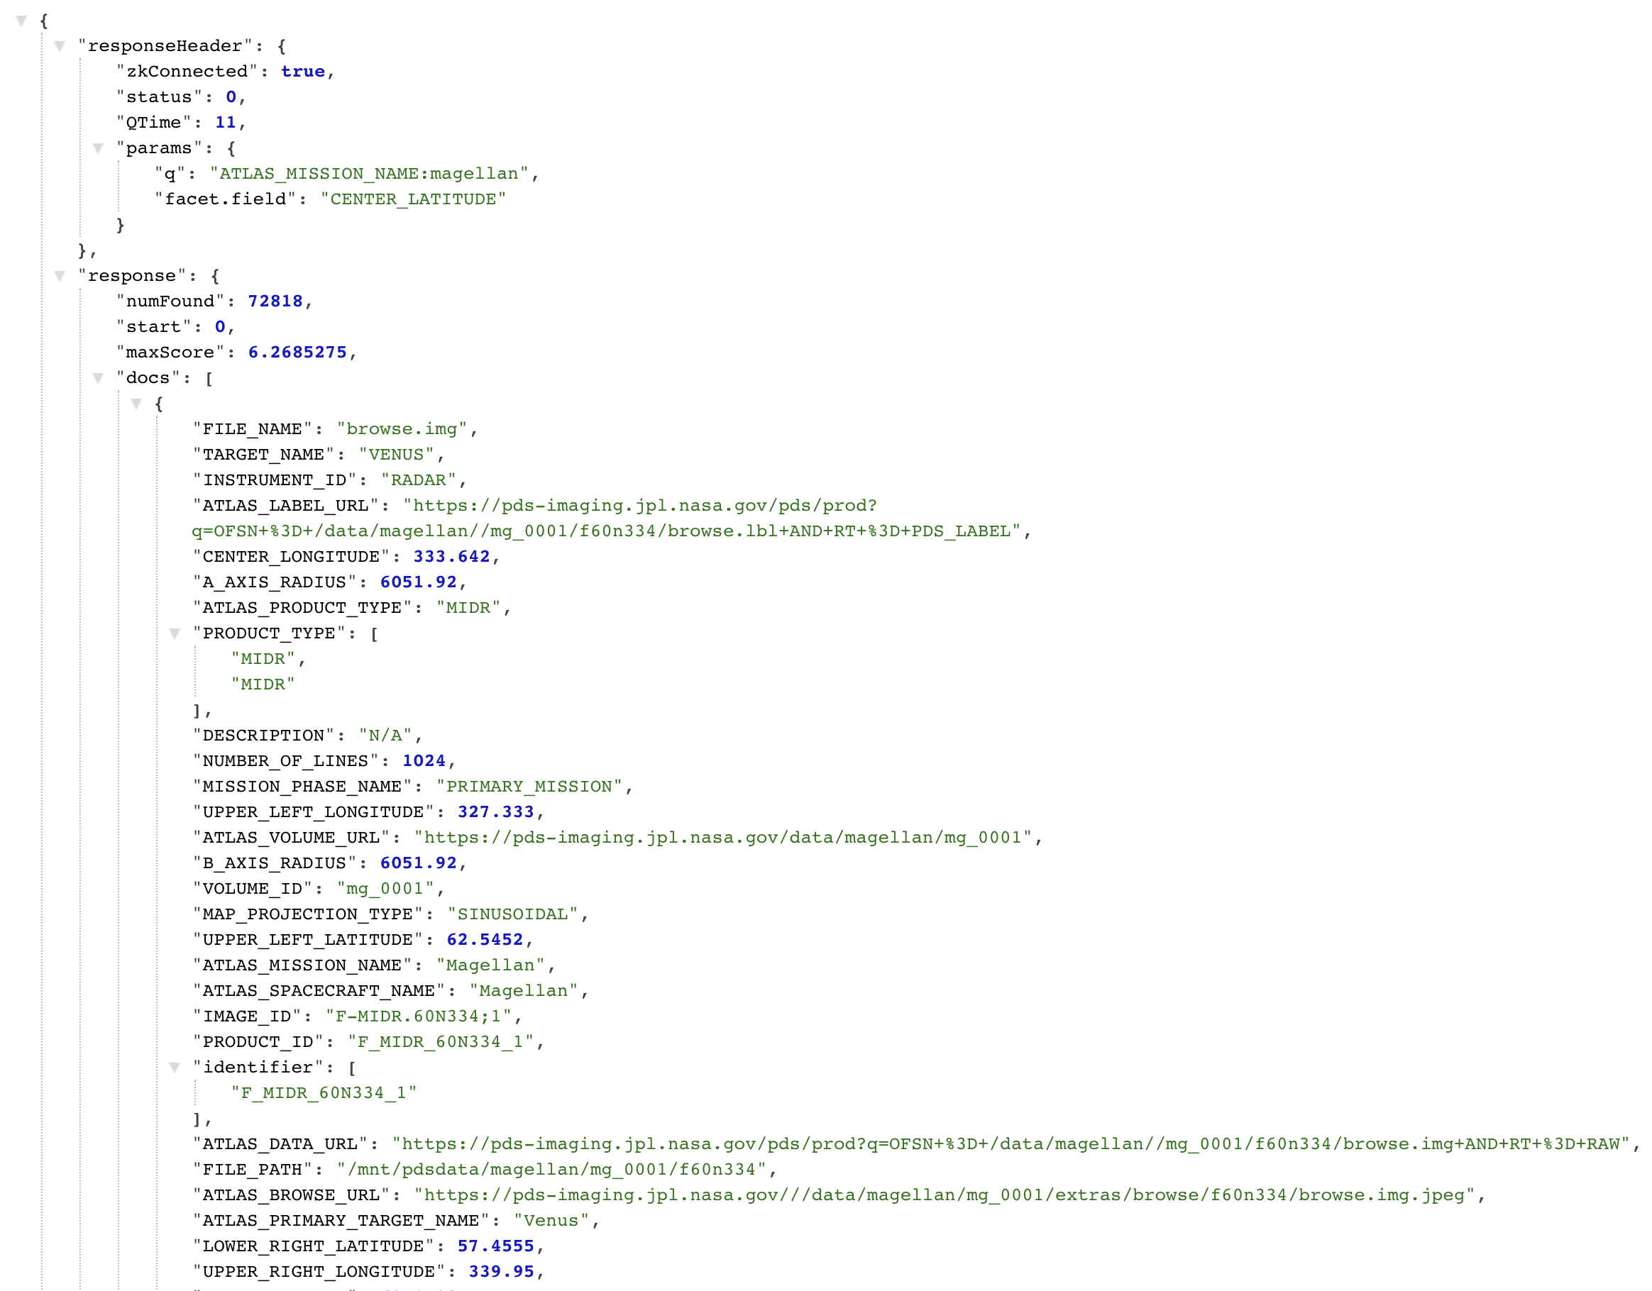
Introduction
5th Planetary Data Workshop & 2nd Planetary Science Informatics and Data Analytics Meeting
Existing backend architecture
Image Atlas
Data access
Search
Solr endpoint exposed to internet
Powerful functionality
Diverse content indexed
40+ million PDS labels
“Common” metadata
Machine-learning enhanced metadata
https://pds-imaging.jpl.nasa.gov/solr

Slide 10
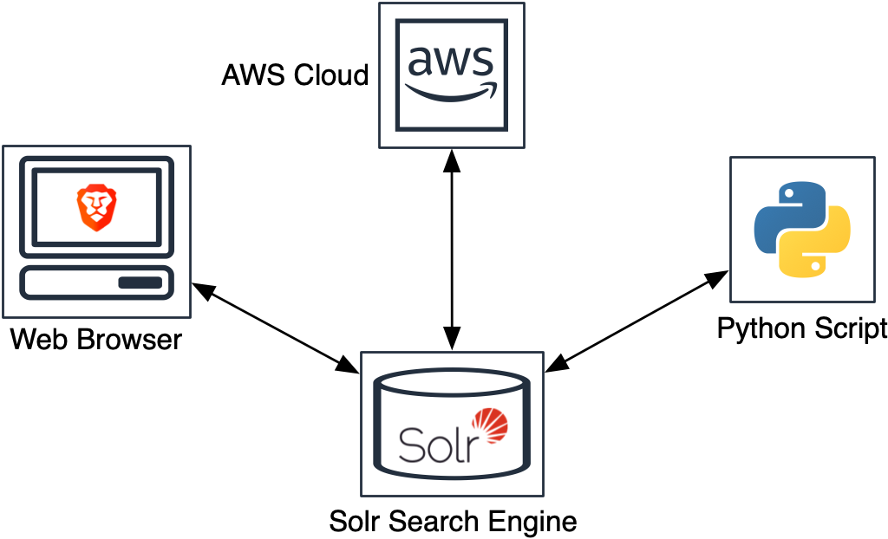
Introduction
5th Planetary Data Workshop & 2nd Planetary Science Informatics and Data Analytics Meeting
Existing backend architecture
Image Atlas
Data access
Search
Solr endpoint exposed to internet
Powerful functionality
Diverse content indexed
40+ million PDS labels
“Common” metadata
Machine-learning enhanced metadata
https://pds-imaging.jpl.nasa.gov/solr

Slide 11
Introduction
5th Planetary Data Workshop & 2nd Planetary Science Informatics and Data Analytics Meeting
Motivation to evolve
Requirements
Solutions
Image Atlas
Multiple data stores
Availability issues
Cumbersome upgrades
Data access
Store on multiple file systems (and object stores!)
Manage cloud egress costs
Search
Easier than Solr API’s learning curve
Easier to impose structure on search results
AWS Cloud
Managed services
Only pay for what you use
Microservices architecture
Decoupled components
Developed in isolation
Communication via APIs
Containerization
Easy to scale
Ephemeral
Orchestration frameworks

Slide 12
Cloud Processing of PDS Archival Products
5th Planetary Data Workshop & 2nd Planetary Science Informatics and Data Analytics Meeting
Overview
Introduction
Architecture
Deployment
Conclusions
Future Work
References

Slide 13
Architecture
5th Planetary Data Workshop & 2nd Planetary Science Informatics and Data Analytics Meeting
Overview
PDS IMG API
Data Access API
Search API
Image Atlas client

Slide 14
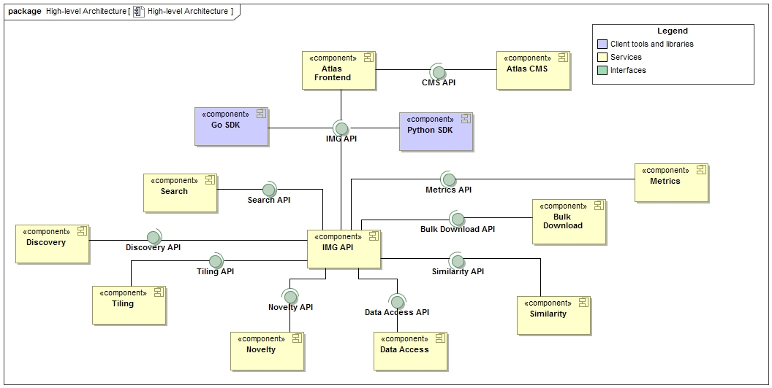
Architecture
5th Planetary Data Workshop & 2nd Planetary Science Informatics and Data Analytics Meeting
Overview

Slide 15
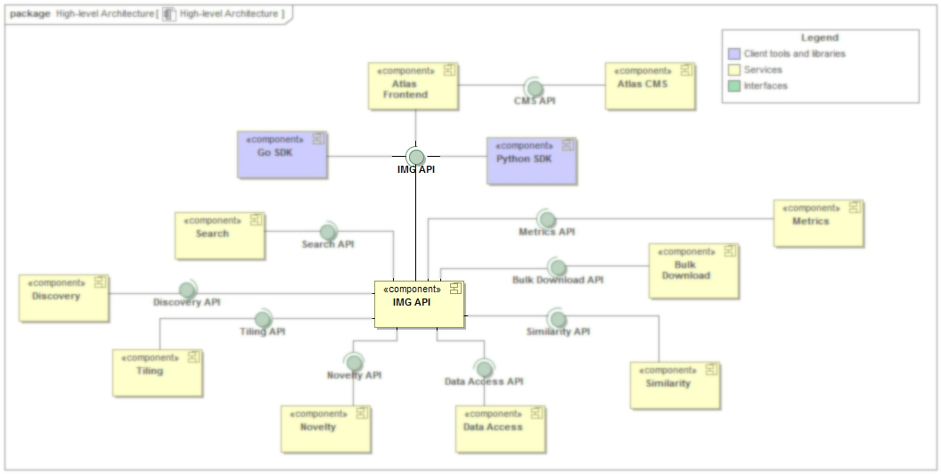
Architecture
5th Planetary Data Workshop & 2nd Planetary Science Informatics and Data Analytics Meeting
PDS IMG API

Slide 16
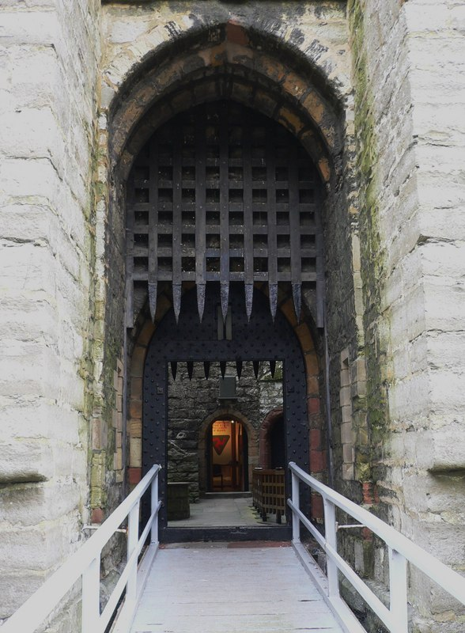
Architecture
5th Planetary Data Workshop & 2nd Planetary Science Informatics and Data Analytics Meeting
PDS IMG API
Only service that allows direct incoming network traffic from users
Single entry point to service network
Imposes A&A
Simple webapp defined by OpenAPI 3.0
Internals of API service mesh can change without impacting user syntax

Slide 17
Architecture
5th Planetary Data Workshop & 2nd Planetary Science Informatics and Data Analytics Meeting
PDS IMG API

Slide 18
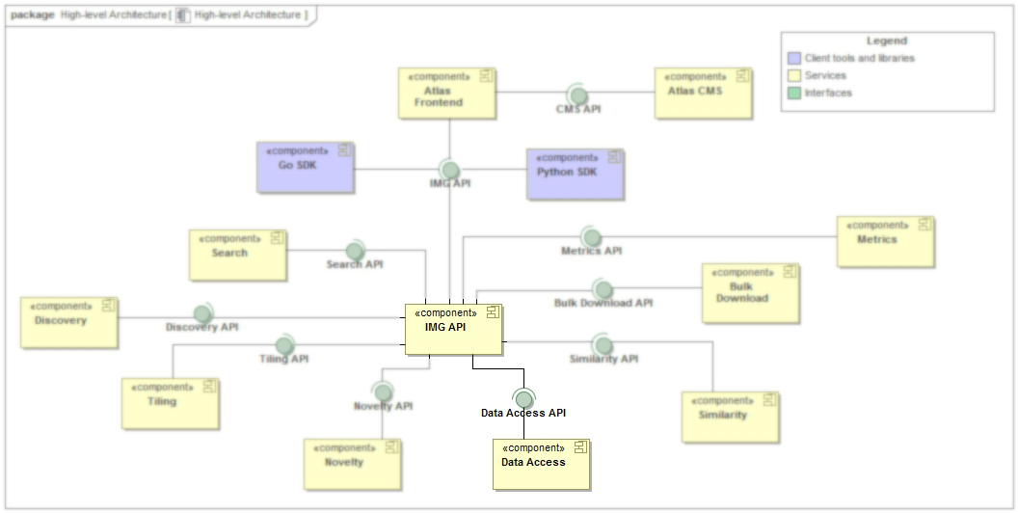
Architecture
5th Planetary Data Workshop & 2nd Planetary Science Informatics and Data Analytics Meeting
Data Access API

Slide 19
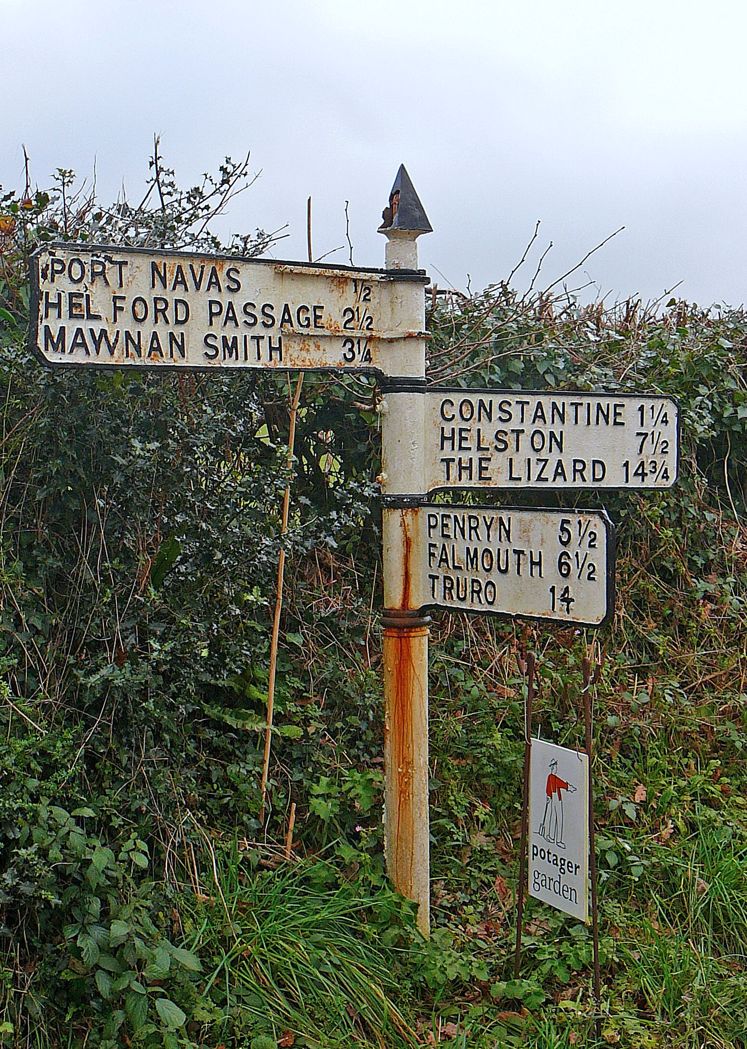
Architecture
5th Planetary Data Workshop & 2nd Planetary Science Informatics and Data Analytics Meeting
Data Access API
Data stored on JPL premises, other data nodes, and in Amazon S3
Need a way to route to multiple locations from a single URL
Manage egress costs (taxpayer money) via user access control, maintaining unfettered access to data for all legitimate use
Implementation inspired by Earth Science’s TEA: https://github.com/asfadmin/thin-egress-app

Slide 20
Architecture
5th Planetary Data Workshop & 2nd Planetary Science Informatics and Data Analytics Meeting
Data Access API
1.
GET /data/cassini/{} 302 https://pds-imaging.jpl.nasa.gov/data/cassini/{}
2.
GET /data/m20/{} 302 https://s3.amazonaws.us-west-2.com/m20data/{}
3.
GET /data/lroc/{} 302 https://astrogeology.usgs.gov/lro/lroc/{}

Slide 21
Architecture
5th Planetary Data Workshop & 2nd Planetary Science Informatics and Data Analytics Meeting
Search API

Slide 22
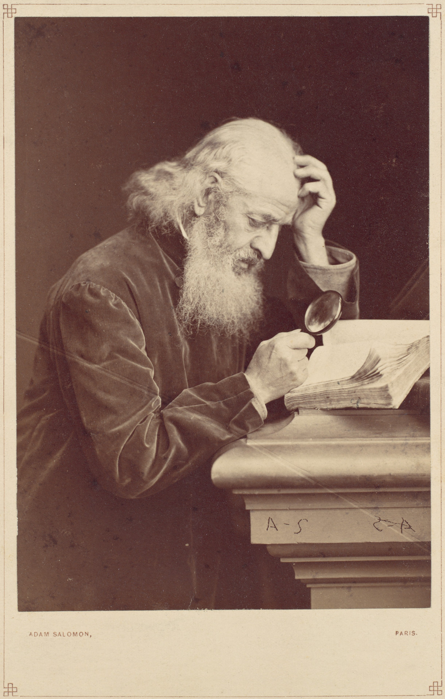
Architecture
5th Planetary Data Workshop & 2nd Planetary Science Informatics and Data Analytics Meeting
Search API
Multiple search indexes breaking up data
Indexes mirroring PDS3/PDS4 label contents
Index for Atlas search
Indexes for machine learning metadata
Search API abstracts away Elasticsearch indexes into a simple-to-use API

Slide 23
Architecture
5th Planetary Data Workshop & 2nd Planetary Science Informatics and Data Analytics Meeting
Search API
1.
GET /search?mission:cassini → 200 https://es.amazonaws.us-west-2.com/cassini/_search
2.
GET /search?mission:m20&has:craters → 200 https://es.amazonaws.us-west-2.com/m20/_search
https://es.amazonaws.us-west-2.com/ml_ldd/_search

Slide 24
Architecture
5th Planetary Data Workshop & 2nd Planetary Science Informatics and Data Analytics Meeting
Image Atlas client

Slide 25
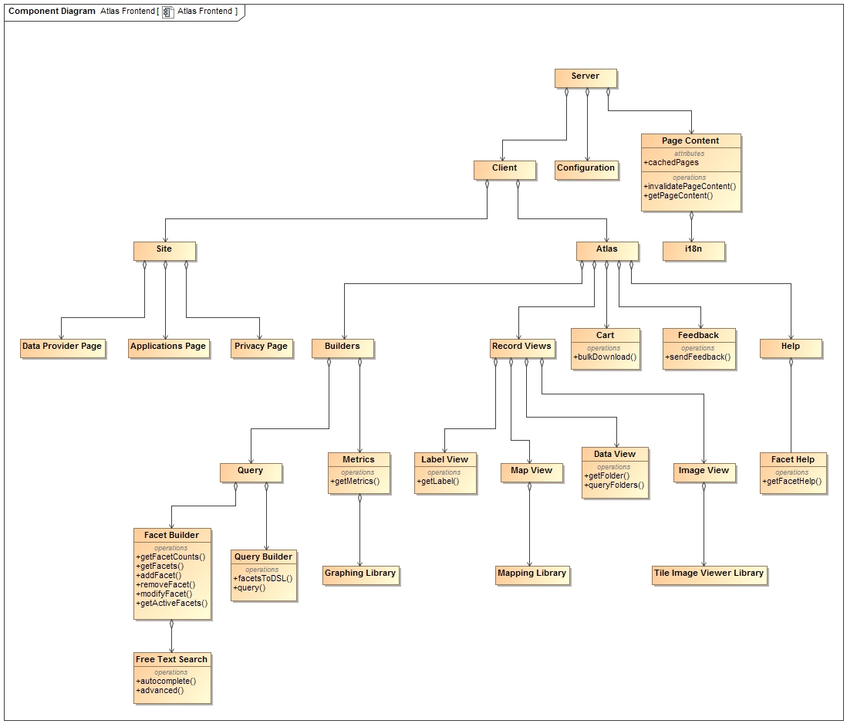
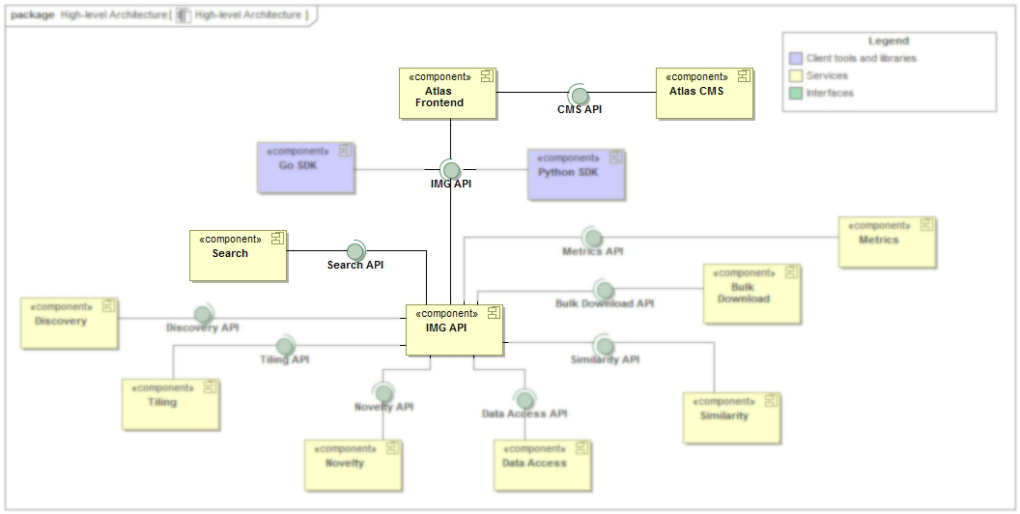
Architecture
5th Planetary Data Workshop & 2nd Planetary Science Informatics and Data Analytics Meeting
Image Atlas Client

Slide 26
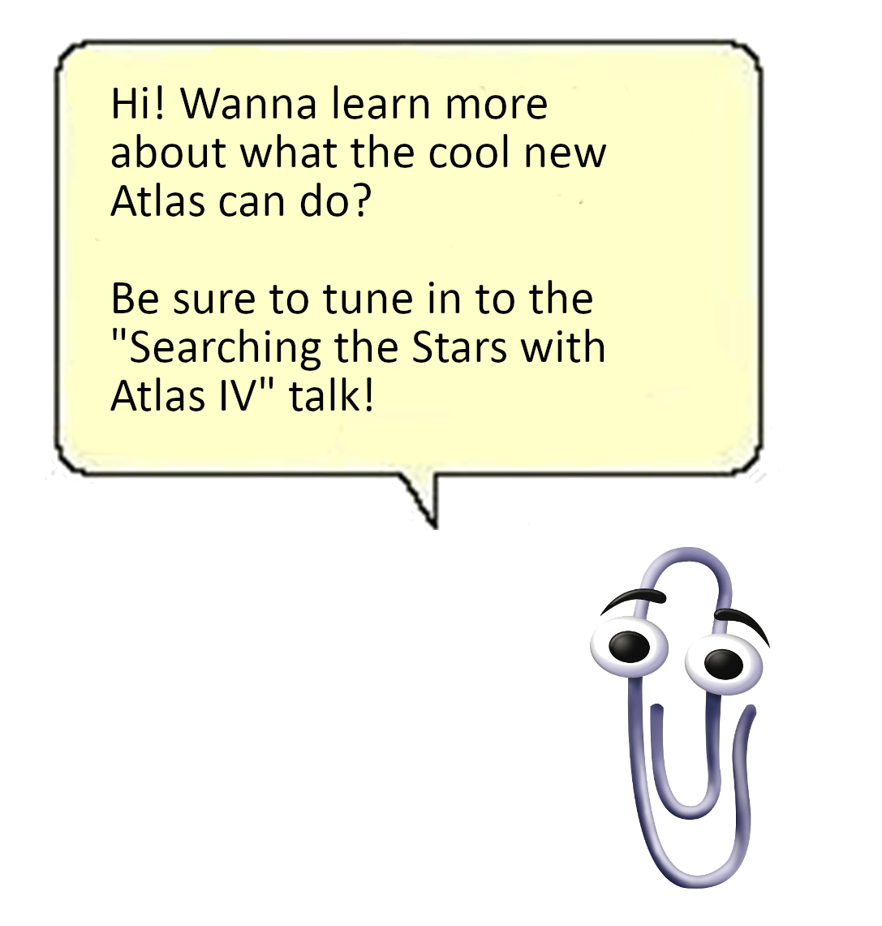
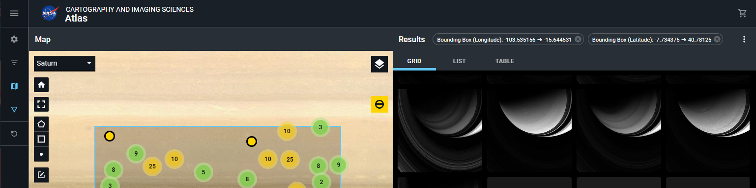
Architecture
5th Planetary Data Workshop & 2nd Planetary Science Informatics and Data Analytics Meeting
Image Atlas client
Redesign of existing Atlas III
Uses PDS IMG API for search
Stores state in database
Just another client of PDS IMG API

Slide 27
Cloud Processing of PDS Archival Products
5th Planetary Data Workshop & 2nd Planetary Science Informatics and Data Analytics Meeting
Overview
Introduction
Architecture
Deployment
Conclusions
Future Work
References

Slide 28
Deployment
5th Planetary Data Workshop & 2nd Planetary Science Informatics and Data Analytics Meeting
PDS IMG API
CloudFront caching at the edge
Request caching
Per-geographical region basis
WAF
Prevents application abuse
Configurable throttling and bypasses
API Gateway (using OpenAPI 3.0 standard)
Routes requests to appropriate service
Supports versioning
Amazon Cognito (tokens)
Integrates with different identity providers (JPL LDAP, Google, Facebook)

Slide 29
Deployment
5th Planetary Data Workshop & 2nd Planetary Science Informatics and Data Analytics Meeting
PDS IMG API

Slide 30
Deployment
5th Planetary Data Workshop & 2nd Planetary Science Informatics and Data Analytics Meeting
Data Access API
CloudFront
Caching at edge
Data caching
API calls vs. multimedia transfer
URL signing
WAF
Prevent abusive asset transfer
“No, you can’t just download the whole archive, sorry”
S3 & BeeGFS for storage
API Gateway (w/ OpenAPI 3.0) for routing

Slide 31
Deployment
5th Planetary Data Workshop & 2nd Planetary Science Informatics and Data Analytics Meeting
Data Access API
1.
User queries IMG API for photo from Mars 2020 EDL

Slide 32
Deployment
5th Planetary Data Workshop & 2nd Planetary Science Informatics and Data Analytics Meeting
Data Access API
1.
User queries IMG API for photo from Mars 2020 EDL
Data Access API determines photo is in S3 bucket s3://m20-data, generates signed URL, and returns 302 to user
2.

Slide 33
Deployment
5th Planetary Data Workshop & 2nd Planetary Science Informatics and Data Analytics Meeting
Data Access API
1.
User queries IMG API for photo from Mars 2020 EDL
Data Access API determines photo is in S3 bucket s3://m20-data, generates signed URL, and returns 302 to user
2.
3.
User follows redirect and downloads their image

Slide 34
Deployment
5th Planetary Data Workshop & 2nd Planetary Science Informatics and Data Analytics Meeting
Data Access API
1.
User queries IMG API for photo of Saturn’s a-ring

Slide 35
Deployment
5th Planetary Data Workshop & 2nd Planetary Science Informatics and Data Analytics Meeting
Data Access API
1.
User queries IMG API for photo of Saturn’s a-ring
Data Access API determines photo is on JPL servers and returns 302 to user
2.

Slide 36
Deployment
5th Planetary Data Workshop & 2nd Planetary Science Informatics and Data Analytics Meeting
Data Access API
1.
User queries IMG API for photo of Saturn’s a-ring
Data Access API determines photo is on JPL servers and returns 302 to user
2.
3.
User follows redirect and downloads their image

Slide 37
Deployment
5th Planetary Data Workshop & 2nd Planetary Science Informatics and Data Analytics Meeting
Search API
CloudFront
API Gateway
Routes to appropriate ES index
Managed Elasticsearch
Single-button upgrades
Easy to setup and maintain

Slide 38
Deployment
5th Planetary Data Workshop & 2nd Planetary Science Informatics and Data Analytics Meeting
Search API

Slide 39
Deployment
5th Planetary Data Workshop & 2nd Planetary Science Informatics and Data Analytics Meeting
Image Atlas Client
ReactJS application built into a Docker image
Wrapped in a Kubernetes Deployment
Stores some state in Strapi CMS
Queries Search API for image products to render
Kubernetes manifests packaged as a Helm chart
Deployed using AWS’s Elastic Kubernetes Service (EKS)

Slide 40
Deployment
5th Planetary Data Workshop & 2nd Planetary Science Informatics and Data Analytics Meeting
Image Atlas Client

Slide 41
Cloud Processing of PDS Archival Products
5th Planetary Data Workshop & 2nd Planetary Science Informatics and Data Analytics Meeting
Overview
Introduction
Architecture
Deployment
Conclusions
Future Work
References

Slide 42
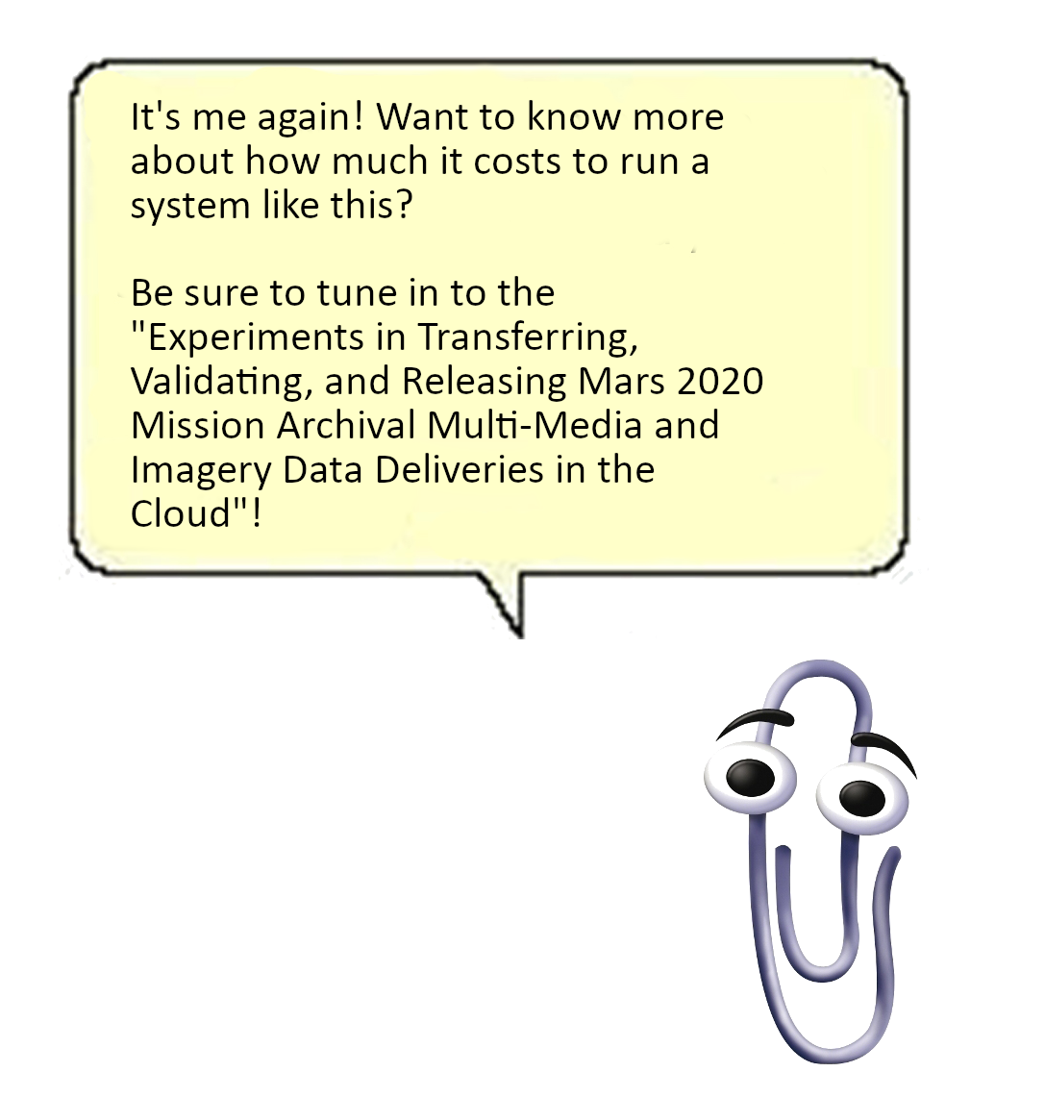
Conclusions
5th Planetary Data Workshop & 2nd Planetary Science Informatics and Data Analytics Meeting
Microservice architectures enable diverse applications to interact with each other and form a complete system
Cloud computing is entirely feasible for data archival workloads
Serving data from the cloud can be cost-efficient if the proper safeguards are put in place

Slide 43
Cloud Processing of PDS Archival Products
5th Planetary Data Workshop & 2nd Planetary Science Informatics and Data Analytics Meeting
Overview
Introduction
Architecture
Deployment
Conclusions
Future Work
References

Slide 44
Future Work
5th Planetary Data Workshop & 2nd Planetary Science Informatics and Data Analytics Meeting
Integrate with PDS API being developed by ENG
Develop SDKs to interact with various API features (Python libraries, Go modules, etc)
Additional API work
Bulk download
Metrics

Slide 45
Cloud Processing of PDS Archival Products
5th Planetary Data Workshop & 2nd Planetary Science Informatics and Data Analytics Meeting
Overview
Introduction
Architecture
Deployment
Conclusions
Future Work
References

Slide 46
References
5th Planetary Data Workshop & 2nd Planetary Science Informatics and Data Analytics Meeting
“PIA24428: High-Resolution Still Image of Perseverance's Landing”. https://photojournal.jpl.nasa.gov/catalog/PIA24428. NASA/JPL-Caltech.
“PDS Imaging Node”. https://pds-imaging.jpl.nasa.gov. NASA/JPL-Caltech
“Firefox logo”. https://commons.wikimedia.org/wiki/File:Firefox_Logo,_2017.png. The Mozilla Foundation, MPL 2 <https://www.mozilla.org/en-US/MPL/2.0/>, via Wikimedia Commons.
“Chrome logo”. https://commons.wikimedia.org/wiki/File:Google_Chrome_icon_(September_2014).svg. Google, Public domain, via Wikimedia Commons.
“Apache Solr logo”. https://commons.wikimedia.org/wiki/File:Apache_Solr_logo.svg. Apache Software Foundation, Apache License 2.0.
“Safari logo”. https://commons.wikimedia.org/wiki/File:Safari_browser_logo.svg. Apple Inc.Vectorization: CMetalCore, Public domain.
“BeeGFS logo”. https://commons.wikimedia.org/wiki/File:BeeGFS-Logo.png. ThinkParQ, CC BY-SA 4.0.
“Brave logo”. https://commons.wikimedia.org/wiki/File:Brave_icon_lionface.png. derivative work: Kreuzschnabel, Public domain. “Python logo”. https://commons.wikimedia.org/wiki/File:Python-logo-notext.svg. www.python.org, GPL.
“Drawbridge and portcullis”. https://commons.wikimedia.org/wiki/File:The_drawbridge_and_portcullis_of_Castle_Rushen_-_geograph.org.uk_-_2109775.jpg. Shazz, CC BY-SA 2.0.
“Signpost”. https://commons.wikimedia.org/wiki/File:Signpost_(3199024949).jpg. Tim Green from Bradford, CC BY 2.0.
“Thinking with magnifying glass”. https://commons.wikimedia.org/wiki/File:-Bearded_Man_with_Magnifying_Glass_Examining_a_Manuscript-_MET_DP111349.jpg. Metropolitan Museum of Art, CC0.
“Clippy”. Microsoft. Public domain.
All other icon assets provided with Omnigraffle Stencil Pack, authorized for limited use by Omni Group.

Slide 48
Backup

Slide 49
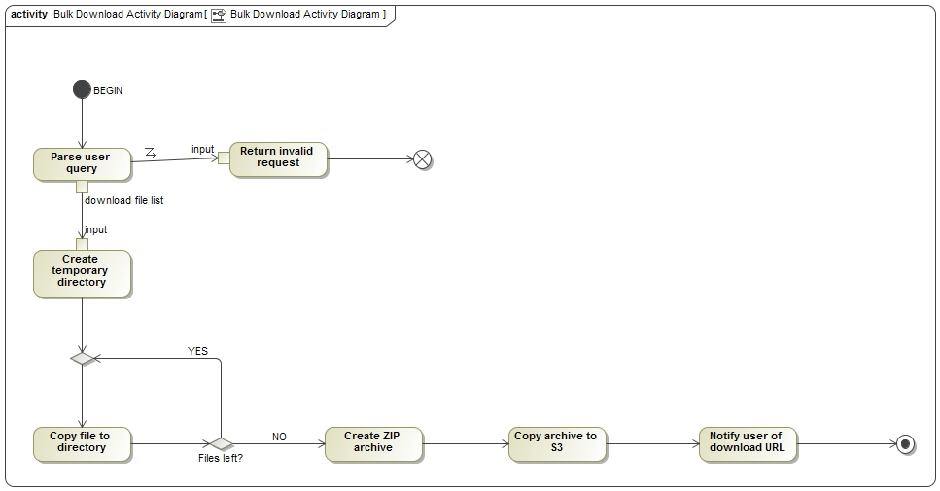

Slide 50
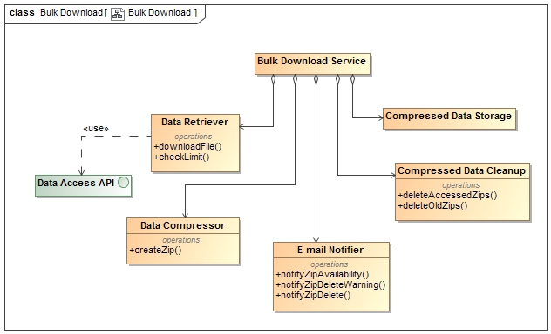

Slide 51
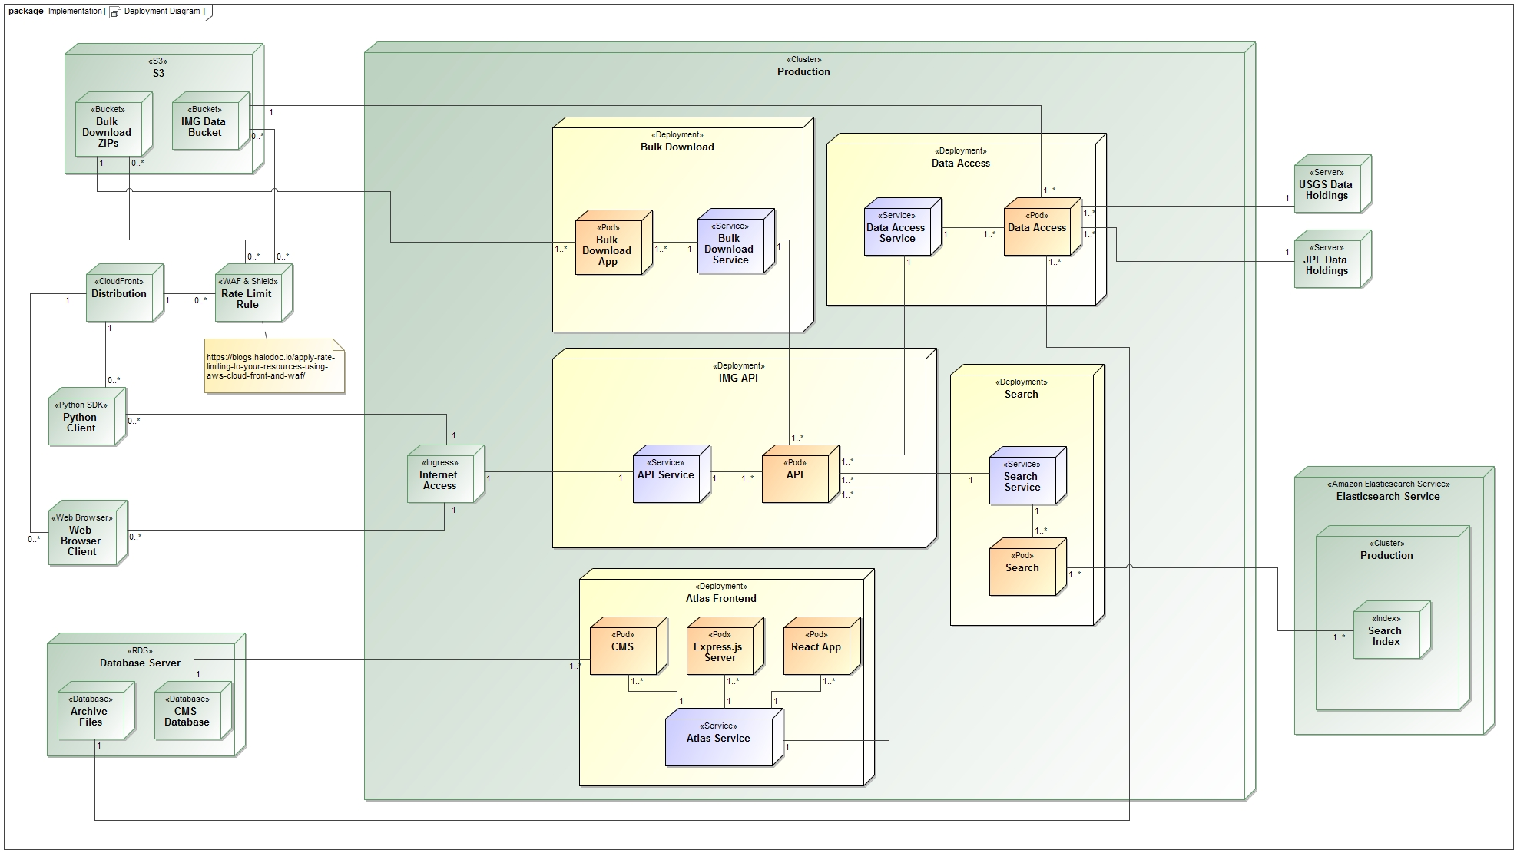

Slide 52
Architecture
5th Planetary Data Workshop & 2nd Planetary Science Informatics and Data Analytics Meeting
PDS IMG API

Slide 53
Architecture
5th Planetary Data Workshop & 2nd Planetary Science Informatics and Data Analytics Meeting
PDS IMG API
Scenario: upgrade “Data Access Service” from v1.0 to v2.0

Slide 54
Architecture
5th Planetary Data Workshop & 2nd Planetary Science Informatics and Data Analytics Meeting
PDS IMG API
Data Access 2.0
Data Access 2.0
Data Access 2.0
GET /data/access/…
GET /data/access/…
GET /data/access/…
t₀
t₁
t₂

Slide 55
Architecture
5th Planetary Data Workshop & 2nd Planetary Science Informatics and Data Analytics Meeting
Search API

Slide 56
Architecture
5th Planetary Data Workshop & 2nd Planetary Science Informatics and Data Analytics Meeting
Data Access API

