Slide 1
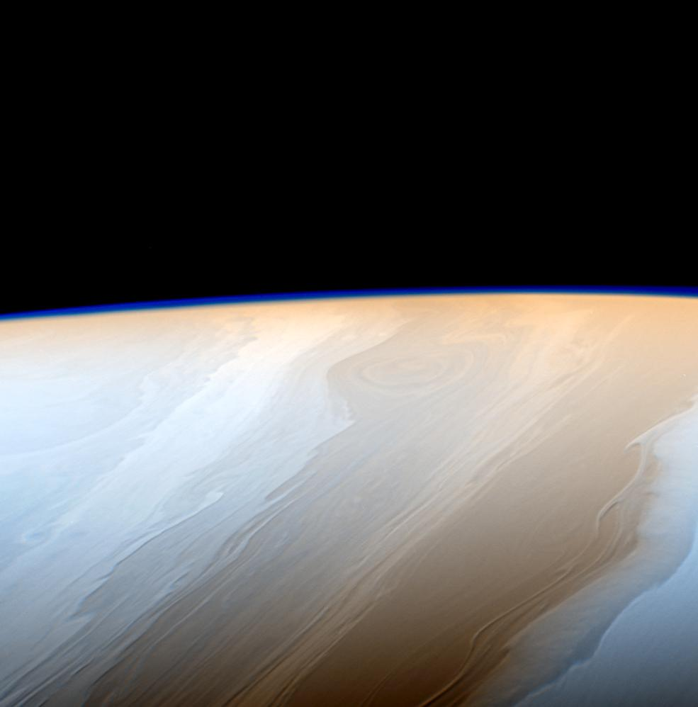

5th Planetary Data Workshop
NASA PDSIMG
Searching the Stars with Atlas IV
Tariq Soliman
Tariq.K.Soliman@jpl.nasa.gov
Kevin Grimes
Kevin.M.Grimes@jpl.nasa.gov
Co-Authors
Anil Natha,
Rishi Verma, Michael McAuley
Thursday, July 1, 2021
©2021 California Institute of Technology. Government sponsorship acknowledged.
PIA21341

Slide 2

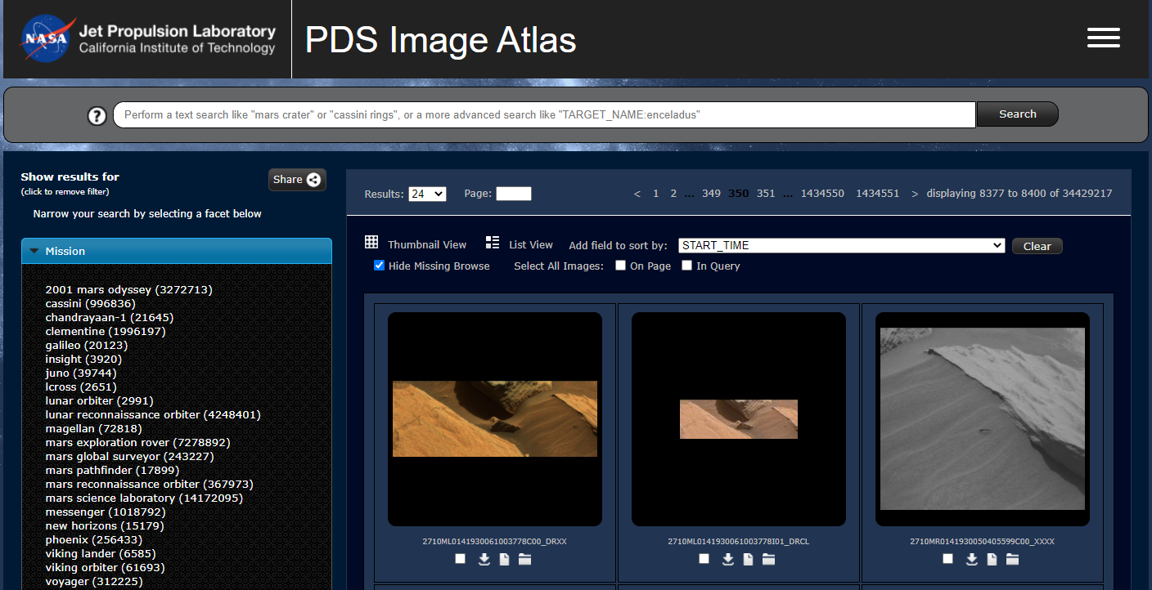
5th Planetary Data Workshop
Get the slides!
Introduction
Current Solution
Atlas III provides effective and efficient search and access to PDS IMG’s archive.
https://bit.ly/3h333oS
However…
  With an ever growing imagery collection and next-generation mission data, we need to ensure all our systems are highly available and scalable
  Keep up with latest web technologies and design principles
  Keep Atlas cohesive
  Meet security and performance expectations
  And Atlas III is almost a decade old now.
To meet these needs, Atlas is undergoing its fourth iteration as Atlas IV.
July 1, 2021
©2021 California Institute of Technology. Government sponsorship acknowledged.
jpl.nasa.gov

Slide 3
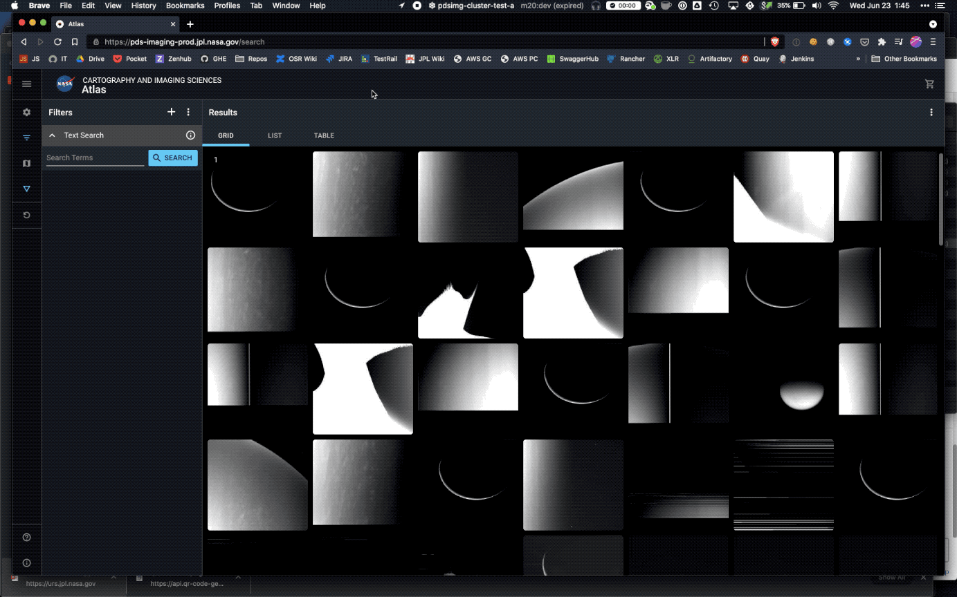
5th Planetary Data Workshop
Get the slides!
Atlas IV
Overview
Atlas IV boasts several improvements over its predecessor and even more features
Codebase redone in favor of modern web technologies
  The previous JQuery-era web application is replaced with a single-page NodeJS, React, Redux, Webpack application
Redesigned using Material UI design principles
Mobile friendly
Enhanced Filtering
Improved geospatial search support
Expanded file exploration functionalities
Streamlined the download process
Each image has its own dedicated and informational page
Tighter integration with Machine Learning classifiers
Still a work in progress.
https://bit.ly/3h333oS
July 1, 2021
©2021 California Institute of Technology. Government sponsorship acknowledged.
jpl.nasa.gov

Slide 4
5th Planetary Data Workshop
jpl.nasa.gov
July 1, 2021
©2021 California Institute of Technology. Government sponsorship acknowledged.
jpl.nasa.gov

